Slide 1
Proteomic analysis of Type XV osteogenesis imperfecta (WNT1 variants)
LIZELUAN
2024/01/08

Slide 2
Background
WNT1 can promote the differentiation of osteoblasts, increase bone density and regulate bone balance. The degree of bone malformation of XV type osteogenesis imperfecta varies from moderate to severe, indicating that different WNT1 activity levels are closely related to the severity of bone malformations.
However, the regulation of WNT1 on protein expression level and post-translational modification remains unclear.
Objection
To conduct proteomic analysis of bone tissues of OI XV patients
To explore the effects of different WNT1 variants on downstream protein synthesis and modification

Slide 3
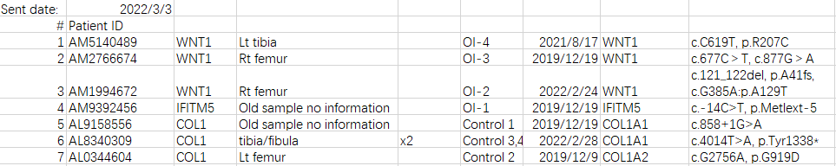
Sample information
8 Samples
OI_IFITM5: A OI patient with IFITM5 mutation
OI_WNT1, OI_WNT2, OI_WNT3 : OI patients with WNT1 variants
Control 1-4: patients with COL1A1/A2 mutation
A
OI_WNT3
OI_WNT2
OI_WNT1
OI_IFITM5

Slide 4
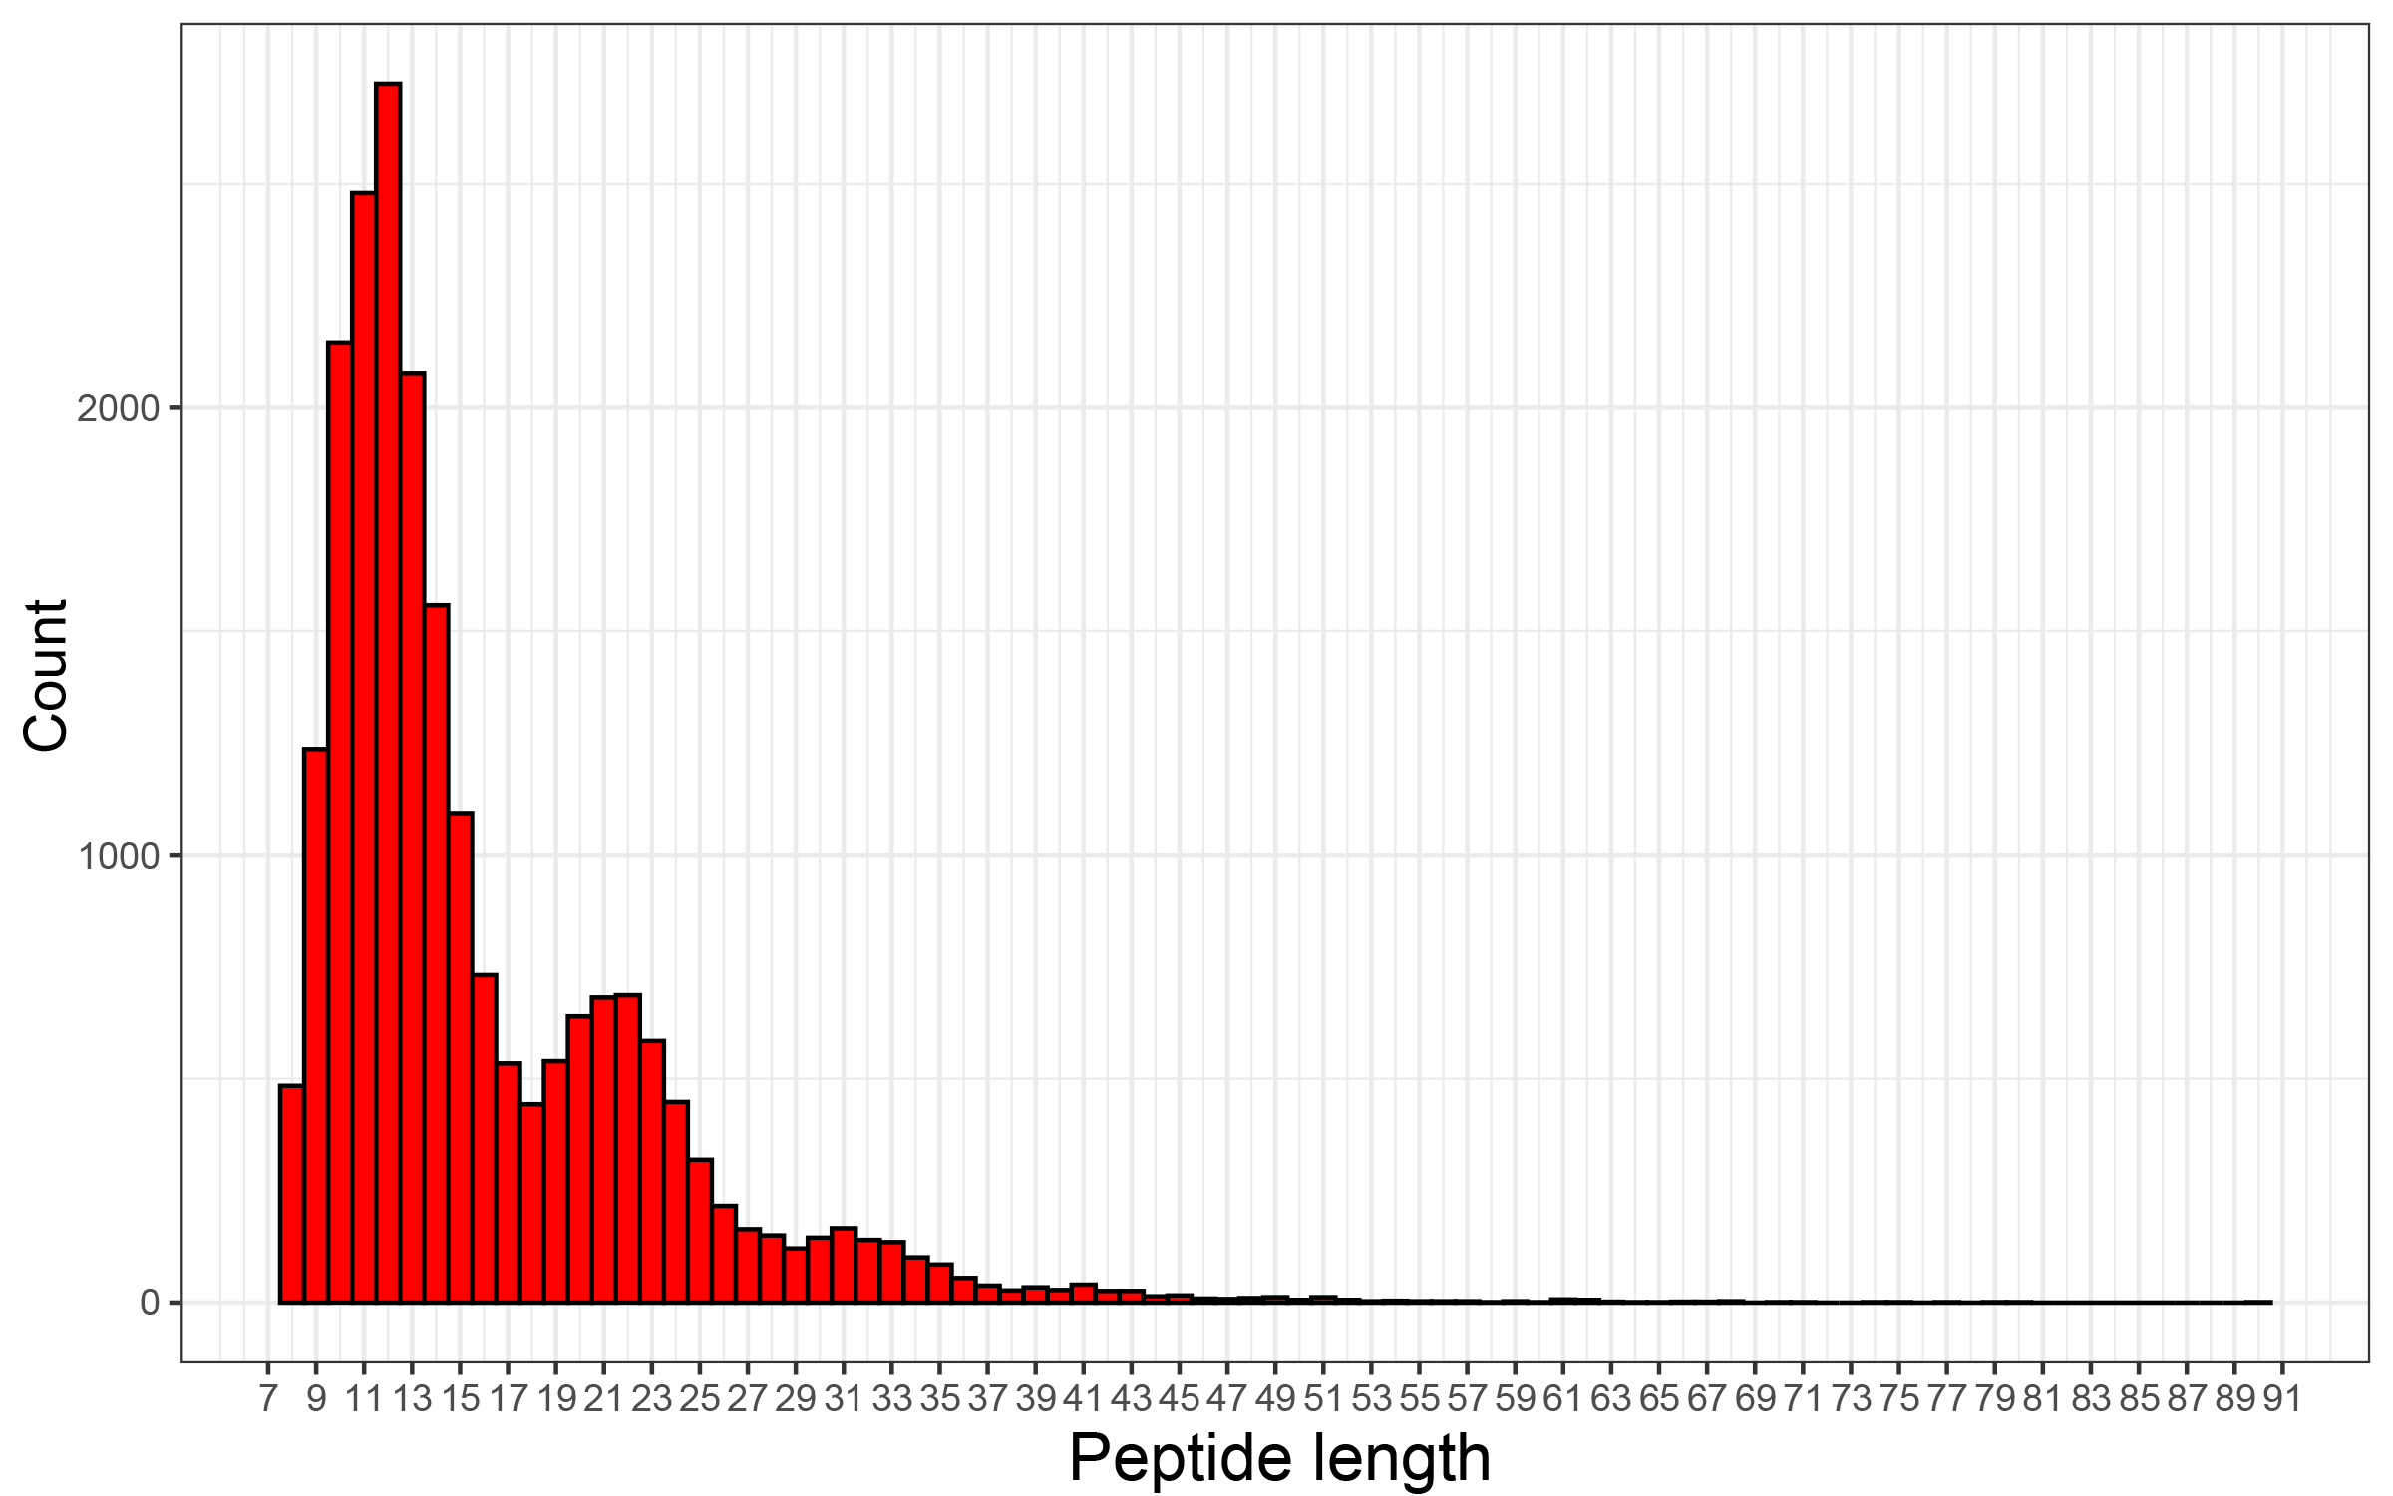
Quality of output
S1. Length distribution of detected peptides
Notes:
Protein quantification of DIA data
DIA-MS raw data were analyzed by the DIA-NN software (v1.8.1) with default parameters, against the Swiss-Prot Human proteome reference database (2023-03-15, 20423 entries). The raw DIA data were quantified and screened by 1% FDR, and then converted to log2 data (i.e. log2 LFQ ). The quantitative information of proteome after screening was used for subsequent analysis.
Figure S1 is the length distribution of detected peptides to evaluate the quality of DIA data.
X coordinate indicates the amino acid length of the identified peptide, and the y coordinate indicates the number of identified peptides of the corresponding length. Most of the peptides detected by mass spectrometry were 7-27 amino acid length.

Slide 5
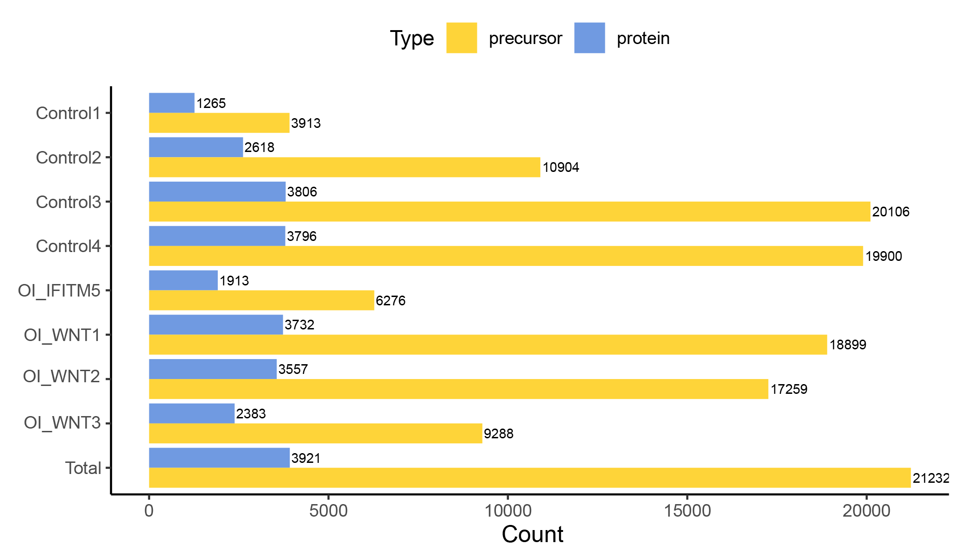
Quality of output
S2. Number of detected protein and peptide types of samples
Notes:
Figure S2 is the number of detected protein types (blue bar) and peptide types (yellow bar) of each sample.
X coordinate indicates sample names, and the y coordinate indicates the number of detected protein types (blue bar) and peptide types (yellow bar) of each sample.

Slide 6
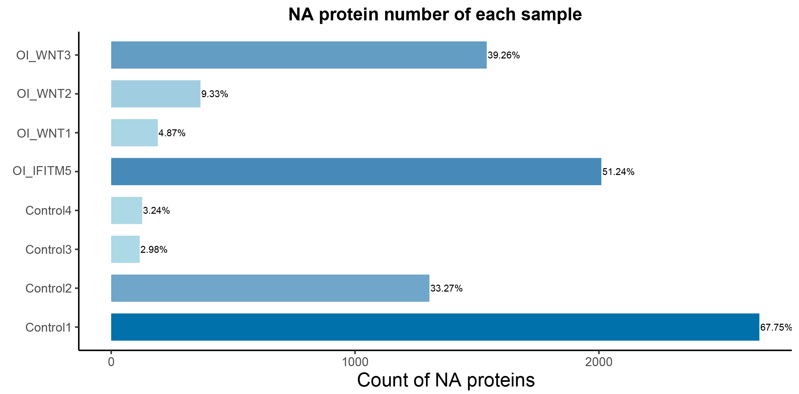
Quality of output
S3. Number of NA proteins in samples
Missing data > 50% might be discarded
Notes:
Figure S3 is the number of NA protein types of each sample.
X coordinate indicates sample names, and the y coordinate indicates the number of protein types not detected in the sample but detected in other samples, that is, the number of missing quantitative data in the sample. The digital label represents the proportion of missing data in the sample.
The lower the proportion of missing data, the higher the consistency of protein detection and quantification, and the higher the quantitative data quality and the analysis accuracy.

Slide 7
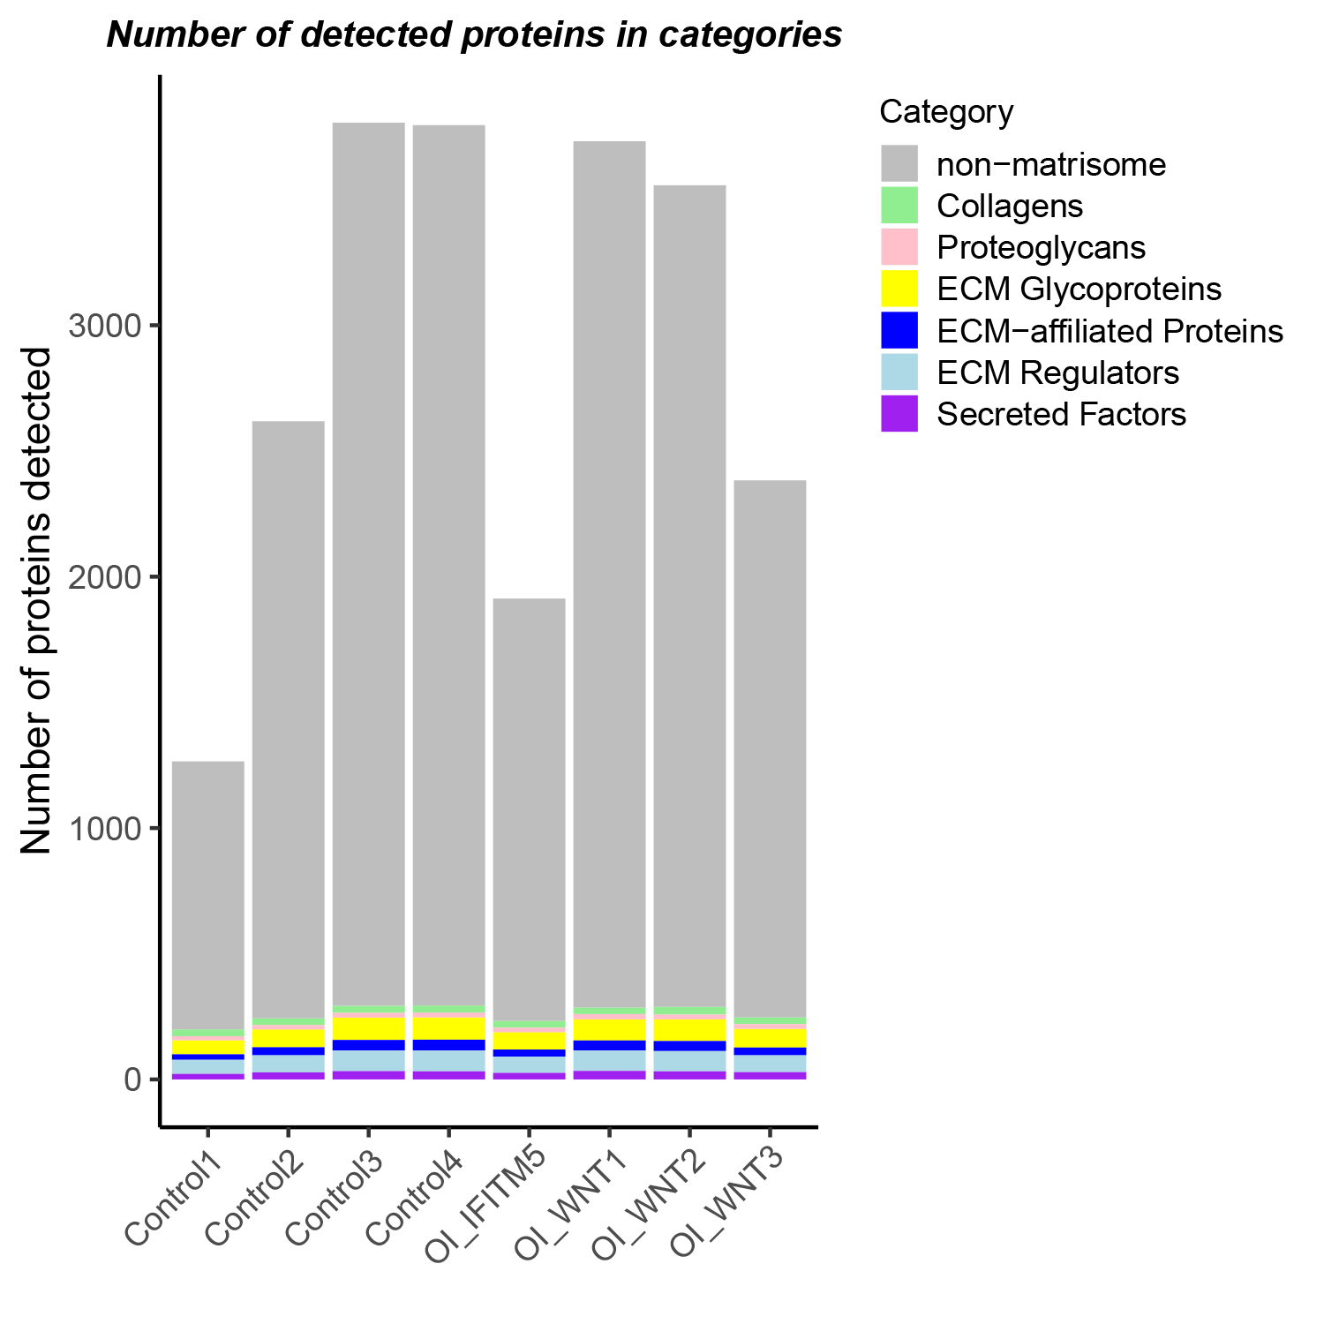
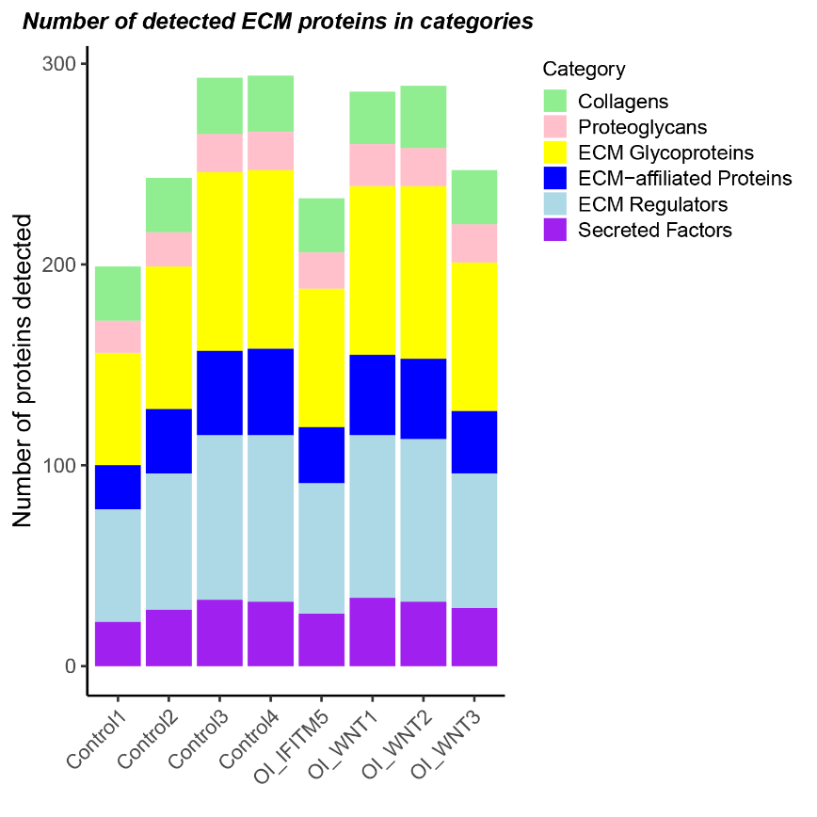
Table 1. Number of detected protein types in different categories per sample.
 | Control1 | Control2 | Control3 | Control4 | OI_IFITM5 | OI_WNT1 | OI_WNT2 | OI_WNT3
ECM Glycoproteins | 56 | 71 | 89 | 89 | 69 | 84 | 86 | 74
Collagens | 27 | 27 | 28 | 28 | 27 | 26 | 31 | 27
Proteoglycans | 16 | 17 | 19 | 19 | 18 | 21 | 19 | 19
ECM-affiliated Proteins | 22 | 32 | 42 | 43 | 28 | 40 | 40 | 31
ECM Regulators | 56 | 68 | 82 | 83 | 65 | 81 | 81 | 67
Secreted Factors | 22 | 28 | 33 | 32 | 26 | 34 | 32 | 29
non-matrisome | 1066 | 2375 | 3513 | 3502 | 1680 | 3446 | 3268 | 2136
Fig1. Number of detected protein types in different categories per sample.
Notes:
The detected protein types were divided into matrisome proteins and non-matrisome proteins. For the matrisome proteins, they were further categorized into core matrisome (ECM proteins, encompassing collagens, proteoglycans, and glycoproteins) and non-core matrisome (ECM regulators, ECM affiliated, and secreted factors), according to a matrisome classification database (matrisomeproject.mit.edu)
Fig1.
Left: Barchart showing the numbers of proteins detected per sample, categorized into matrisome (coloured) or non-matrisome proteins (grey)
Right: Barchart showing the composition of the matrisome and matrisome-associated proteins. Heights of bars indicate the number of proteins in each category detected per sample.
Table1. Supplementary data of Fig1.

Slide 8
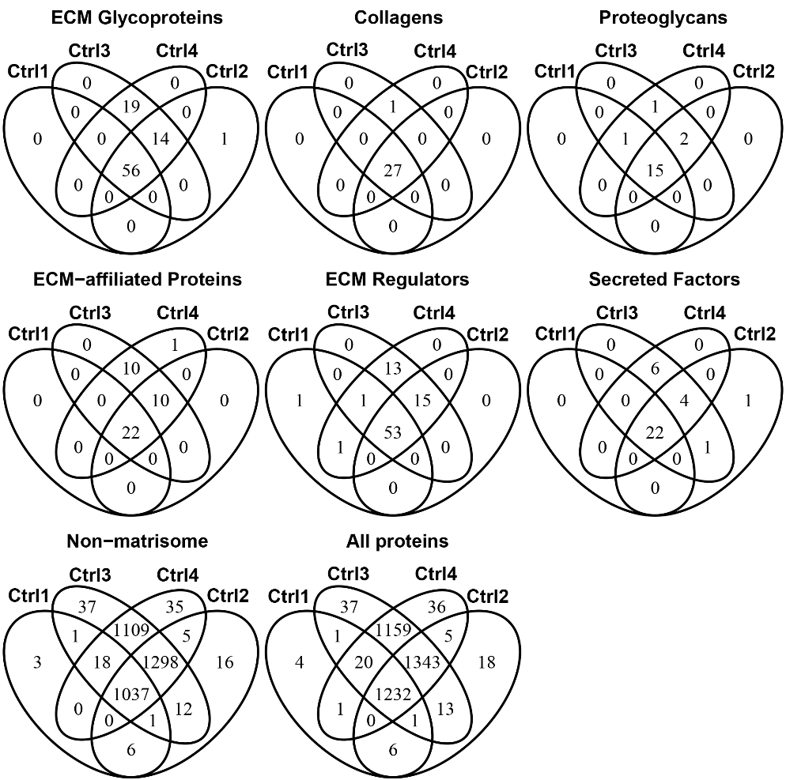
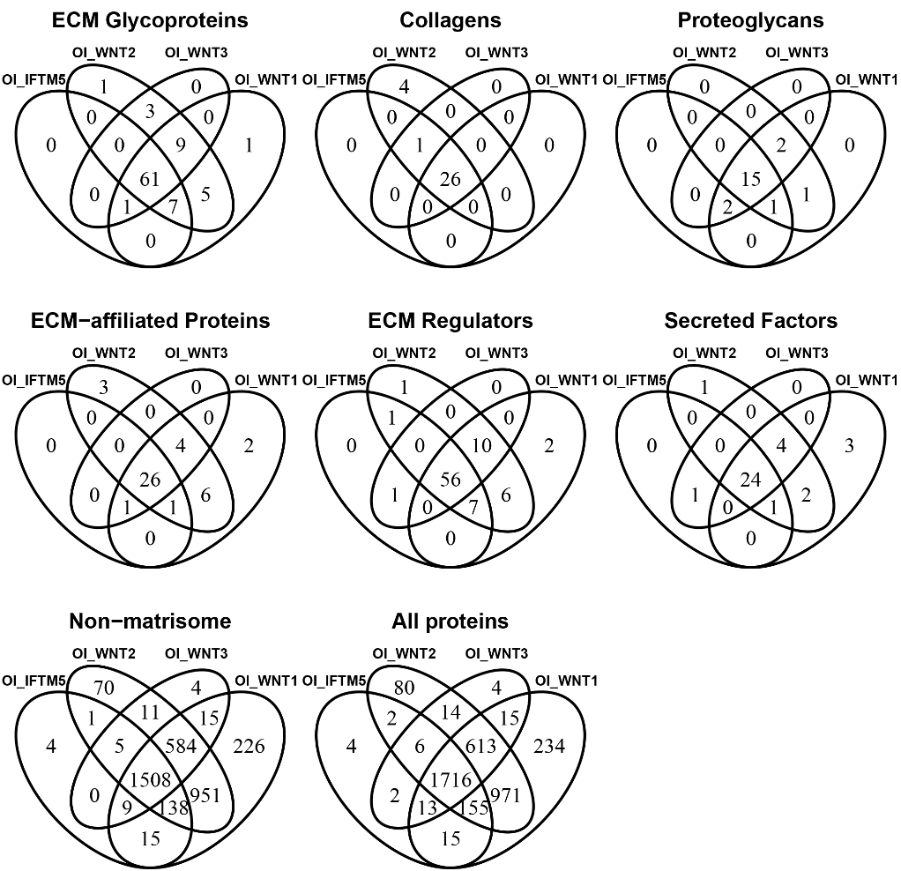
Fig2. Venn diagram of detected proteins among sample groups (control group, OI group) in each protein category
Control group
OI group (including WNT1 and IFITM5 variant OI patients)
Notes:
Fig2. Venn diagrams of detected proteins among samples (control group, experimental group) in each protein category.

Slide 9
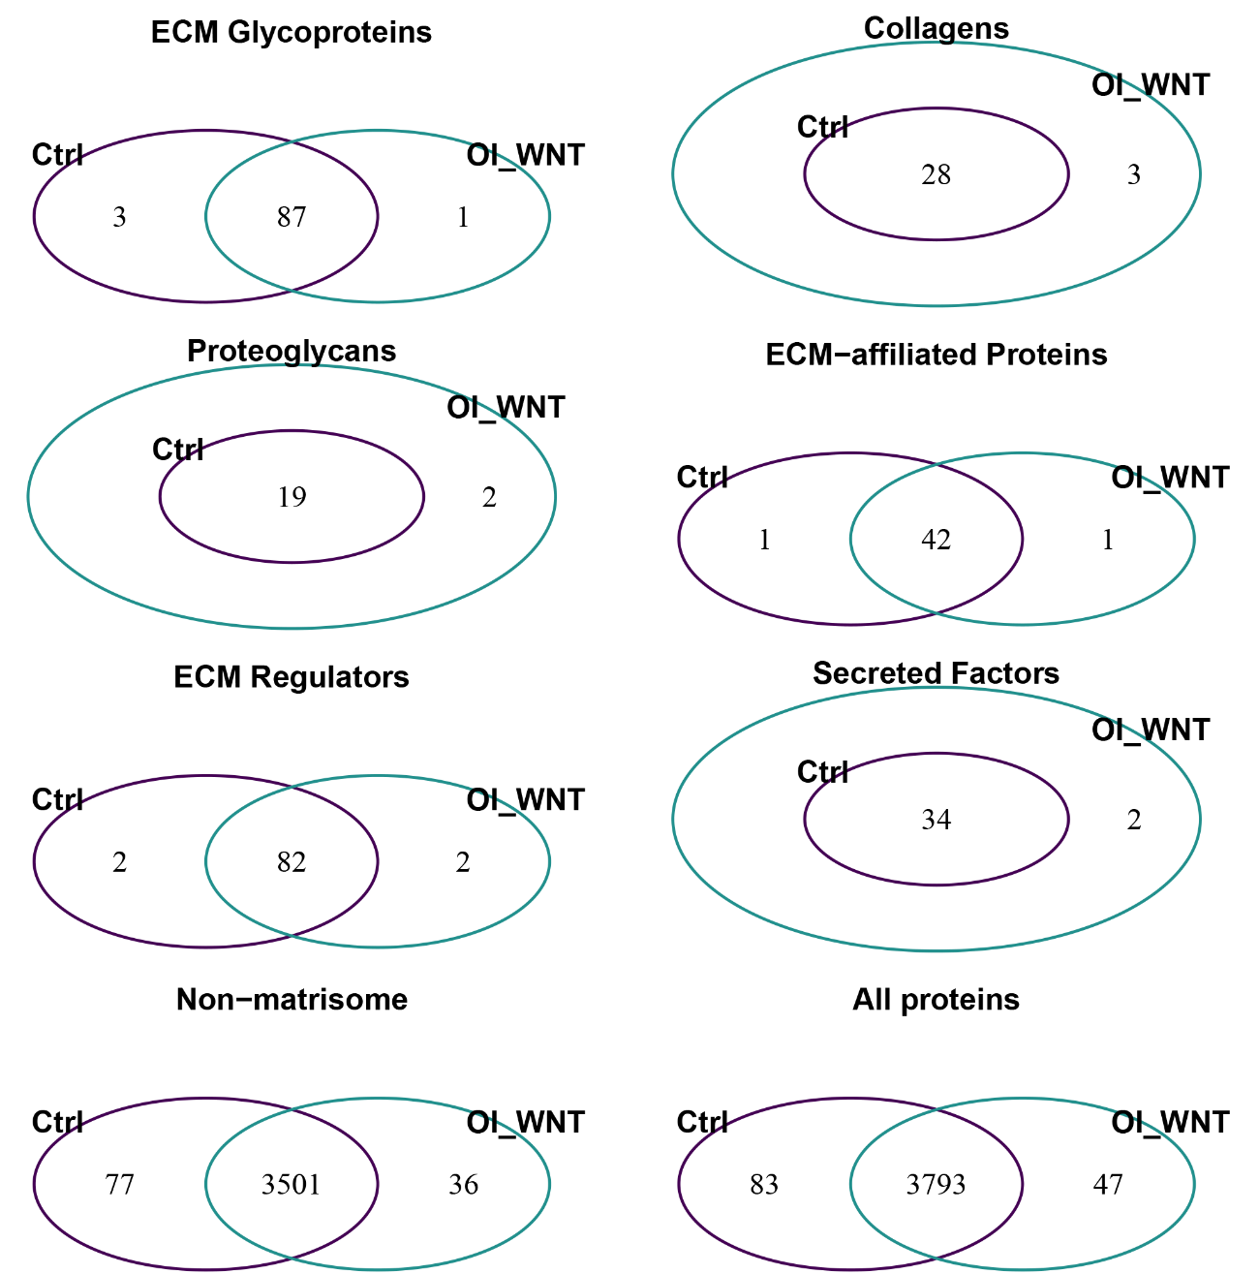
Fig3. Venn diagram of detected proteins in the WNT1-OI cohort and Control group
COL9A1, COL9A3, COL9A2
ELN, FBLN7, GLDN
MFAP5
PRG2, PRG3
GPC4
CLEC3A
CTSO, LOXL2
MMP8, SERPINB10
S100B,
HGFAC
Notes:
Fig3. Venn diagrams showing the number of detected proteins (detected in at least one sample of the group) in WNT1-OI cohort and control group.
It can be seen that ELN, FBLN7, GLDN, GPC4, CTSO, LOXL2 were only detected in control group. WNT1 variant OI disease seems to be related to the low expression of these 6 matrisome proteins, which can be the potential target of treatment.

Slide 10
Detected number and expression level comparison of WNT1-OI cohort and the Control group, per protein category

Slide 11
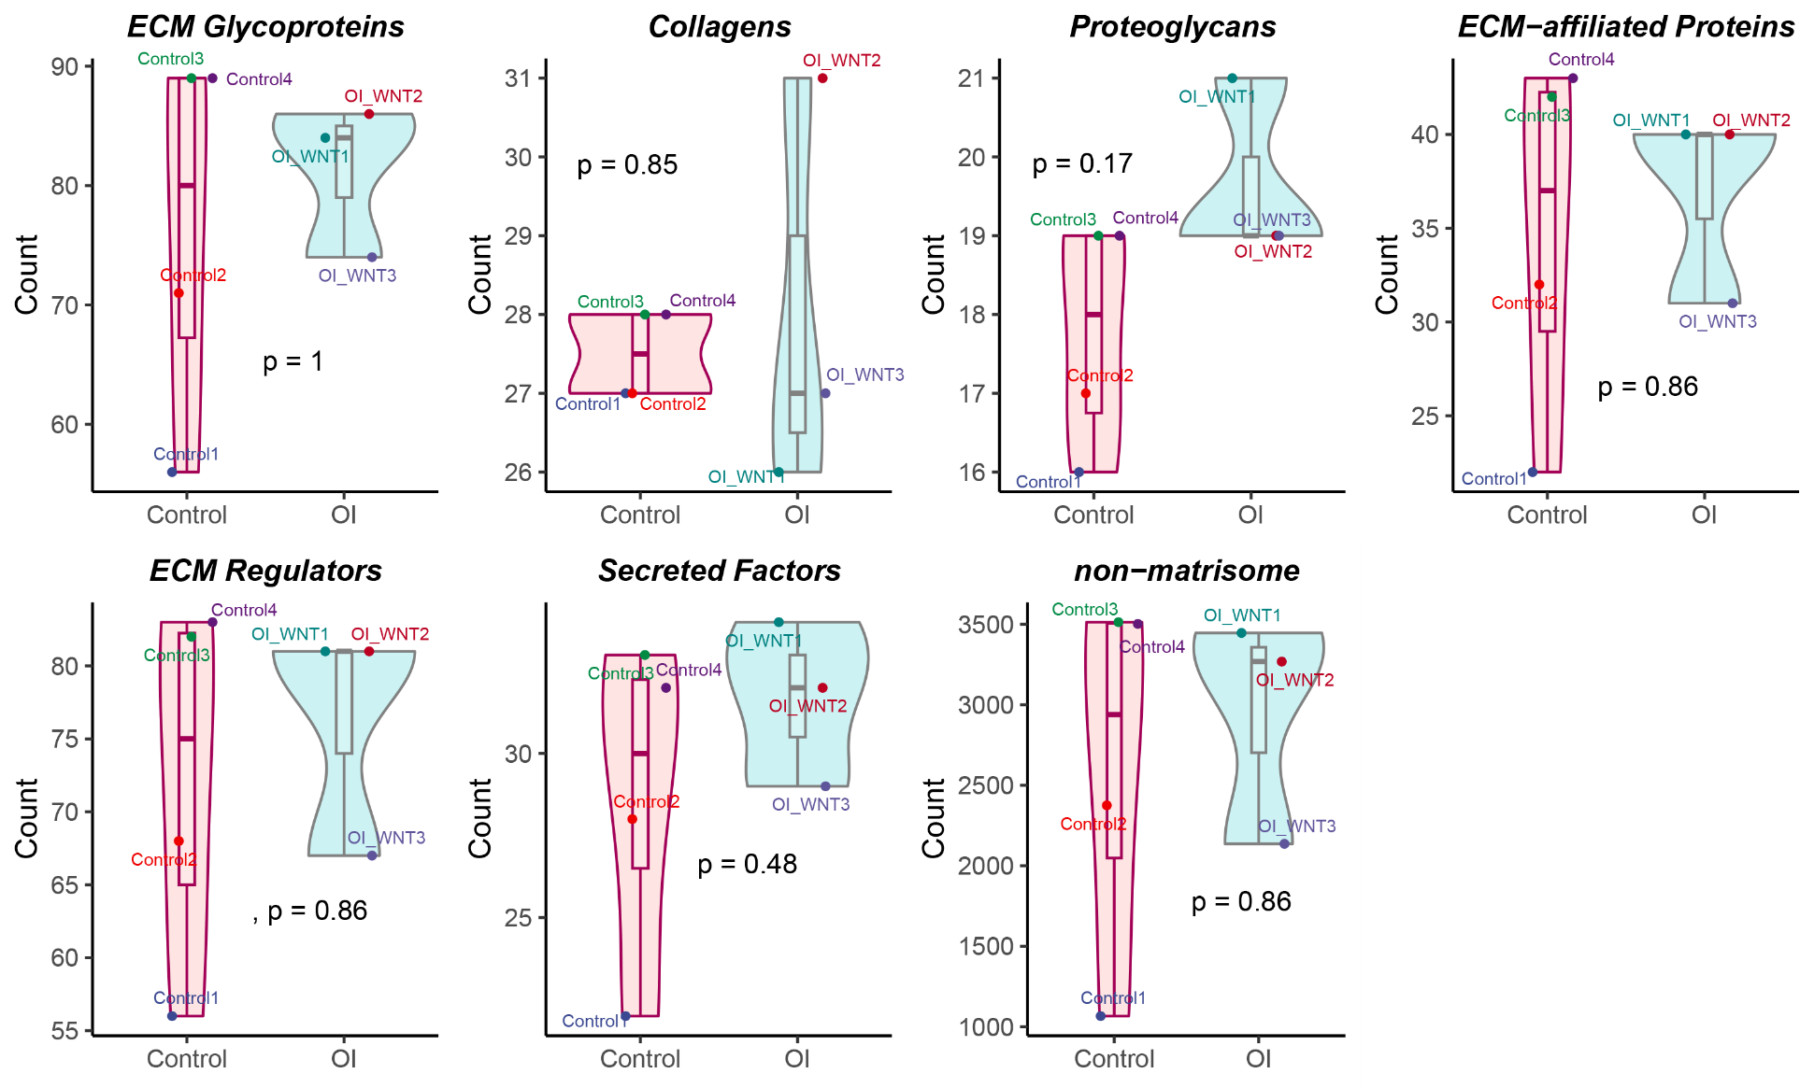
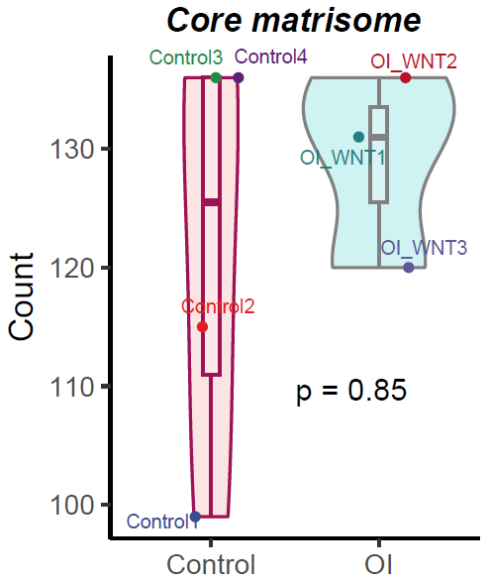
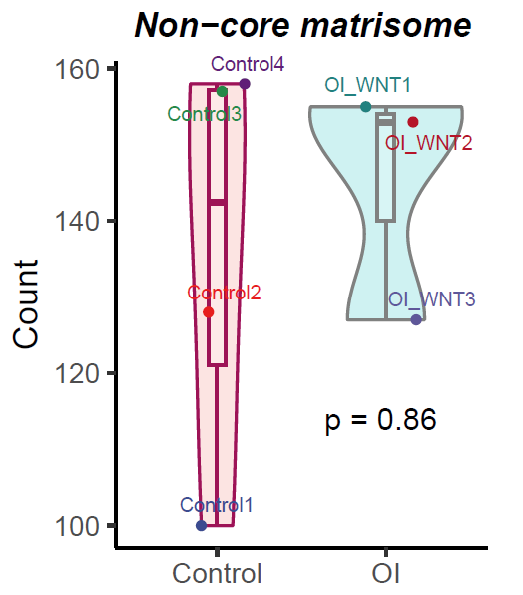
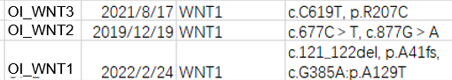
Fig3a. Violin plot of the detected protein number in the Control group and the WNT1-OI cohort , per protein category
Notes:
Fig3a. Violin plots of the detected protein number in the control group (marked as Control on the x axis) and the WNT1-OI cohort (marked as OI on the x axis), per protein category.
Core matrisome: ECM Glycoproteins, ECM Glycoproteins, ECM Glycoproteins
non-Core matrisome: ECM-affiliated Proteins, ECM Regulators, Secreted Factors
non-matrisome: proteins which are not matrisomes
it seems sample OI_WNT1 and sample OI_WNT2 (heterozygous mutation) has similar profile of the detected protein numbers among categories, except for the collagens. But this may related to the low total protein number detected in OI_WNT3.

Slide 12
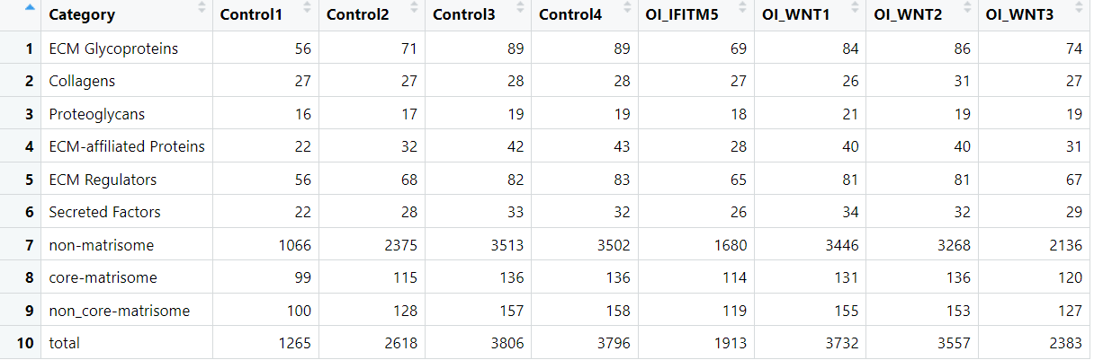
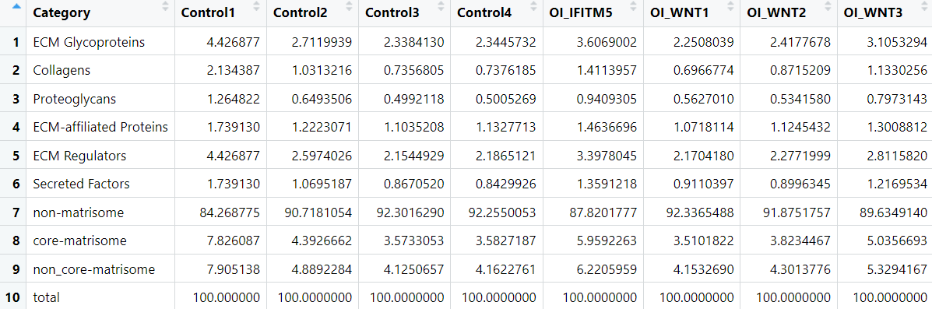
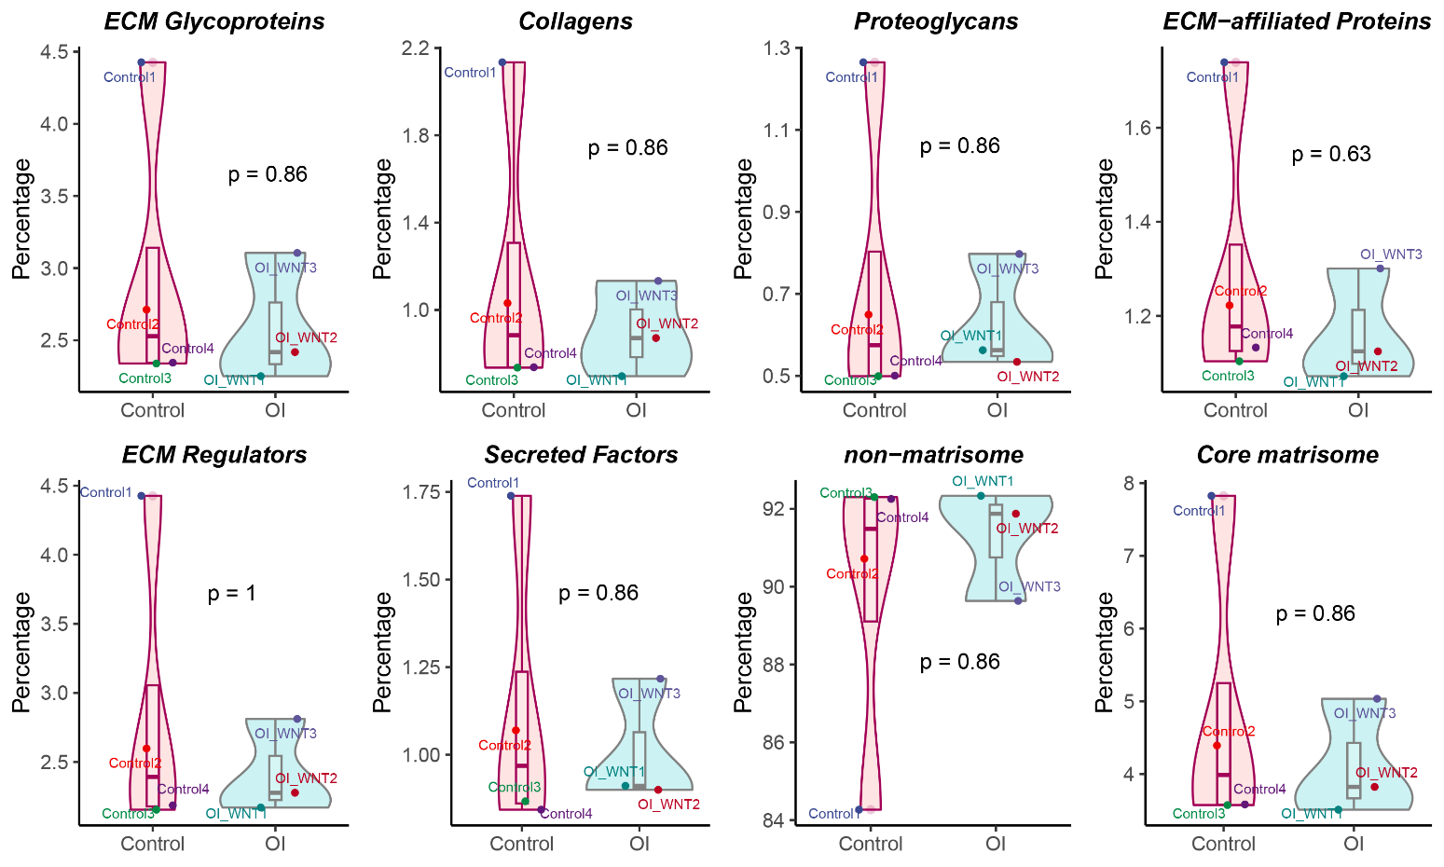
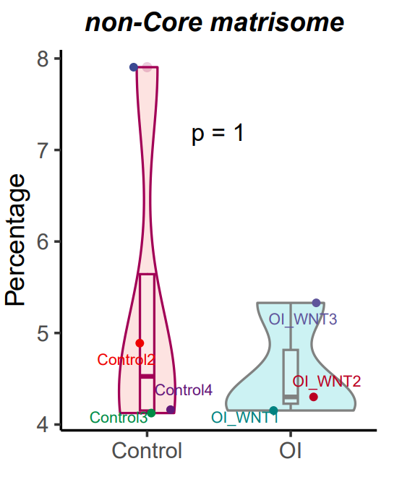
Fig3b. Violin plot of the detected protein percentage, per protein category
convert into percentage representation
Notes:
To eliminate the effect of the total protein number detected for each sample, the detected protein number was converted into percentage of the detected protein number in the total protein numbers of the sample.
It can be still seen that sample OI_WNT1 and sample OI_WNT2 (heterozygous mutation) has similar profile of the detected protein percentage among all the categories.

Slide 13
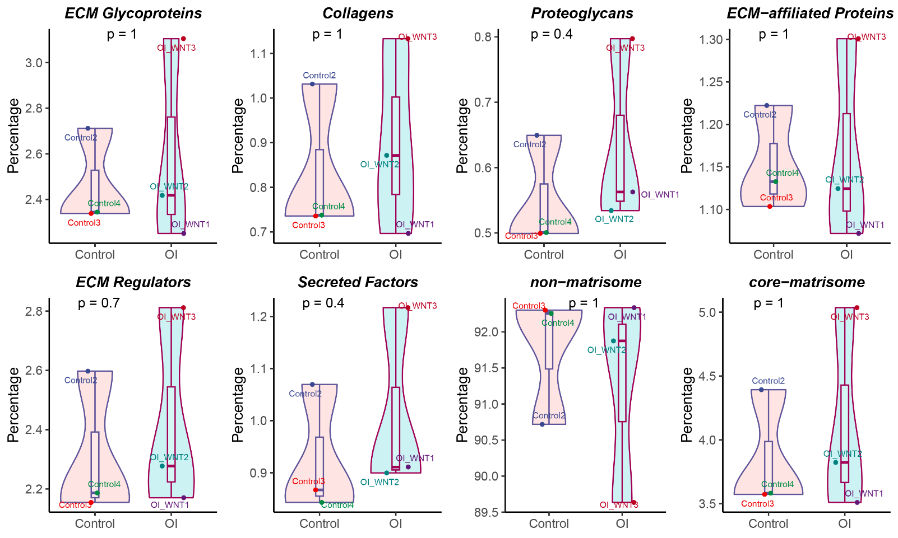
Fig3c. Violin plot of the detected protein percentage, per protein category (without the sample Control1)

Slide 14
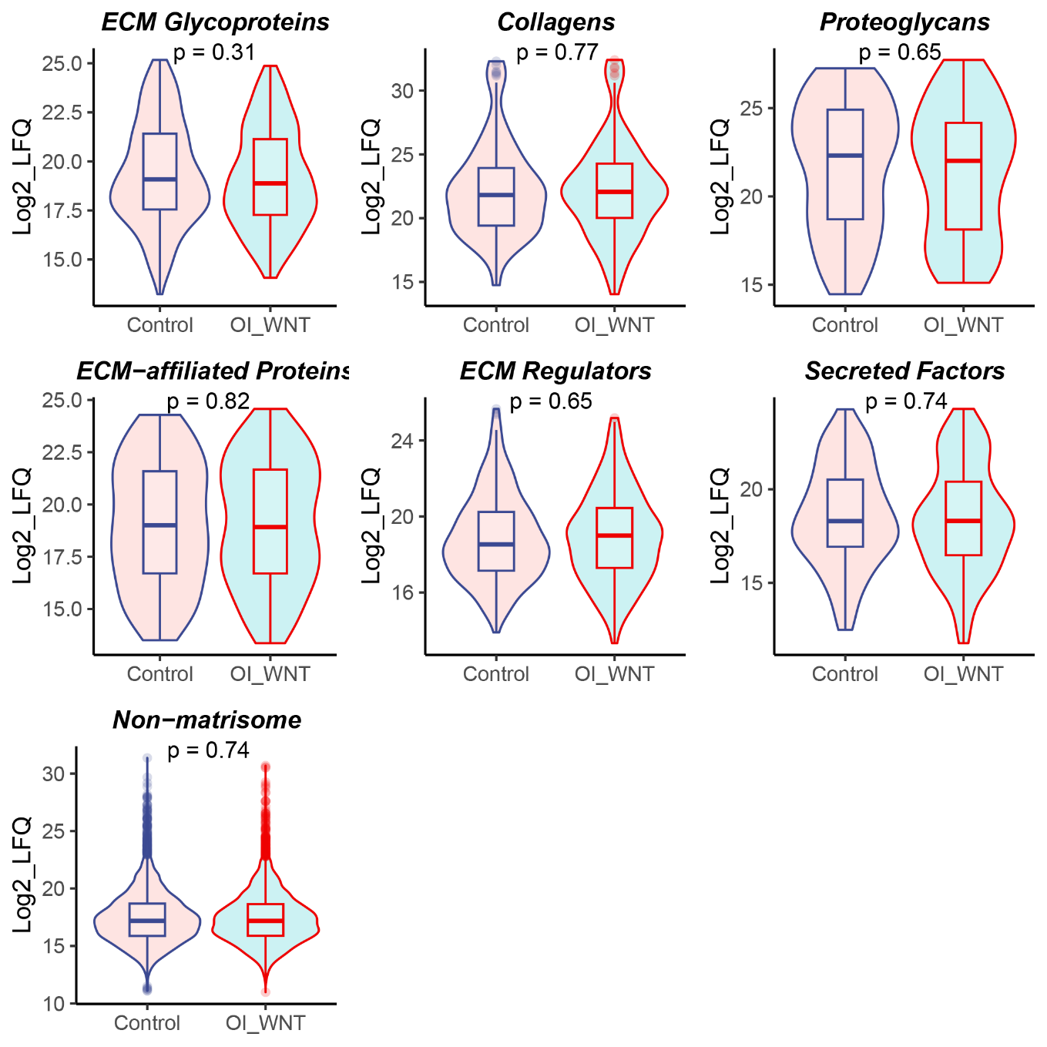
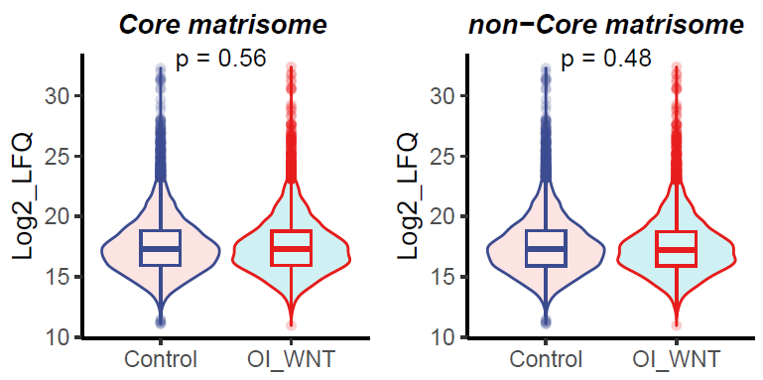
Fig4. Violin plot of the detected protein expression levels in the Control group and the WNT1-OI cohort, per protein category
Notes:
Fig4. Violin plots of the protein expression levels (log2LFQ) of detected proteins in the control group (marked as Control on the x axis) and the WNT1-OI cohort (marked as OI_WNT on the x axis), per protein category. p value: p value of Wilcoxon test.
It can be seen that the WNT1-OI cohort has relatively higher expression level on the ECM regulators than the control group.

Slide 15
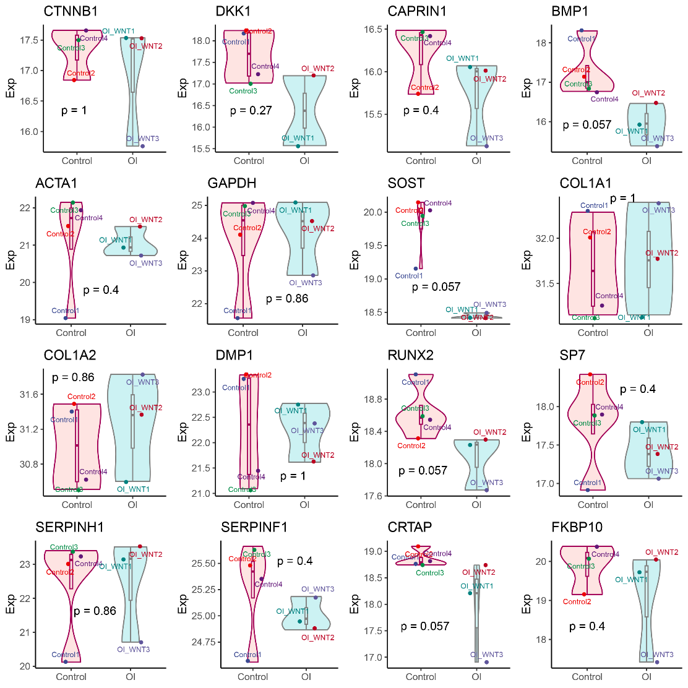
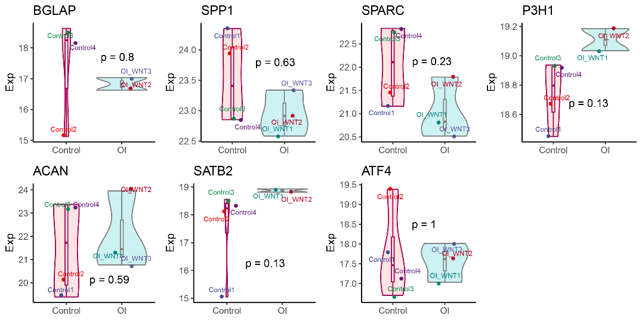
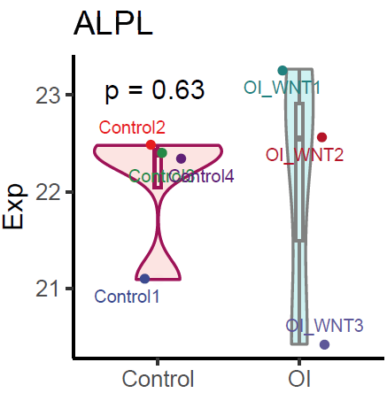
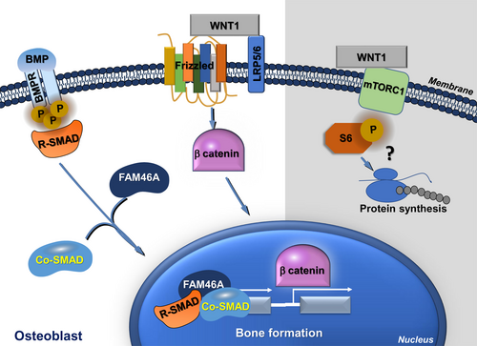
Fig5. Protein expression level of some selected genes
OI WNT1 variants might refers to mTORC1 signaling pathway
Notes:
Fig5. Protein expression levels (log2LFQ) of some selected genes between Control group (marked as Control on the x axis) and WNT1-OI cohort (marked as OI on the x axis) by Wilcoxon test.
Including: osteocyte marker gene (SOST, DKK1, DMP1), osteoblast marker gene (COL1A1, COL1A2, BGLAP), osteoblast differentiation related genes (RUNX2, SP7, SERPINF1, CTNNB1, ATF4, SATB2), and collagen I processing and modification related genes (LH1, P4H1, P3H1, CRTAP, PPIB, SERPINH1, BMP1, LEPRE1, PKBP10), mineralization and bone formation related genes (TNFRSF11B (OPG), TNSF11(RANKL), both not detected for technical restriction, ALPL).
It can be seen that SOST expression was extremely low in WNT1-OI cohort. The expression of RUNX2 is low in the WNT-OI cohort. The expression of COL1A1, COL1A2, BGLAP in WNT1-OI cohort is similar to the control group. The process of osteoblast differentiation might have problem.
CRTAP, BMP1 is also low in the WNT1-OI cohort. WNT1 variant OI disease might be also related to the defect in collegen I processing???????.
The β-catenin expression level does not show huge difference between the WNT-OI cohort and the control group. So OI WNT1 disease might refers to another pathway mTORC1 signaling pathway, which regulates the osteoblast differentiation. It might be related to BMP expression.
Besides, it seems sample OI_WNT1 and sample OI_WNT2 (heterozygous mutation) has similar profile of these selected genes, while sample OI_WNT3 (homozygous mutation) differs from them, especially on the β-catenin, CRTAP protein.

Slide 16
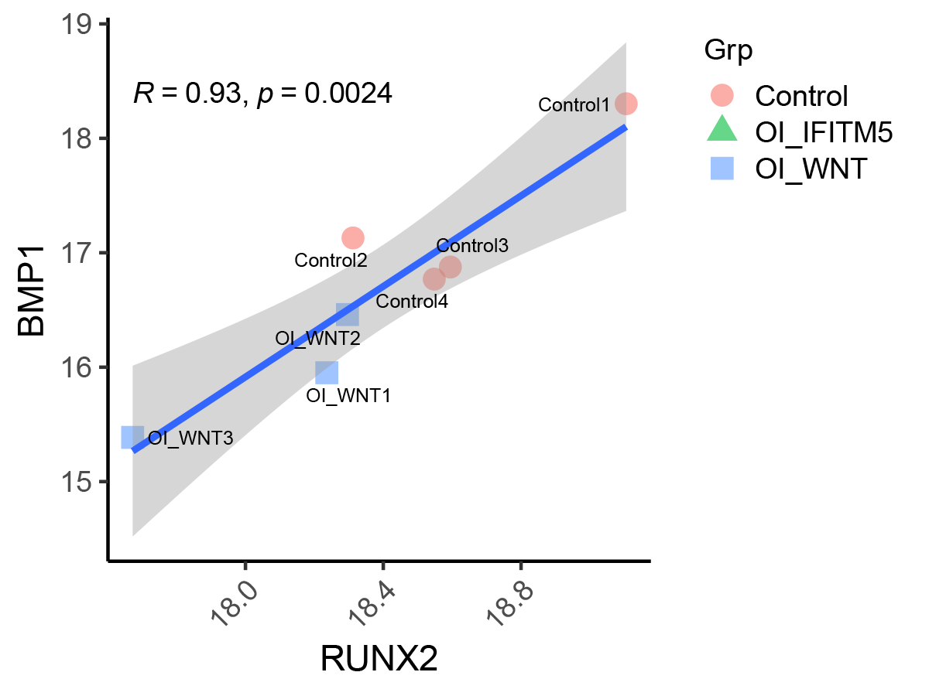
Fig6. Scatter plot of protein expression level relationship between RUNX2 and BMP1
Notes:
Fig6. Protein expression level relationship between RUNX2 and BMP1
Scatter-plot among Runx2, CRTAP, BMP1, SOST have been tried and the scatter-plot between RUNX2 and BMP1 showing their co-linearity.
BMP1 might activate RUNX2? A literature mentioned that BMPs can activate RUNX2 expression.
BMP1 can activate BMP2 and BMP4, which might stimulate RUNX2 expression?

Slide 17
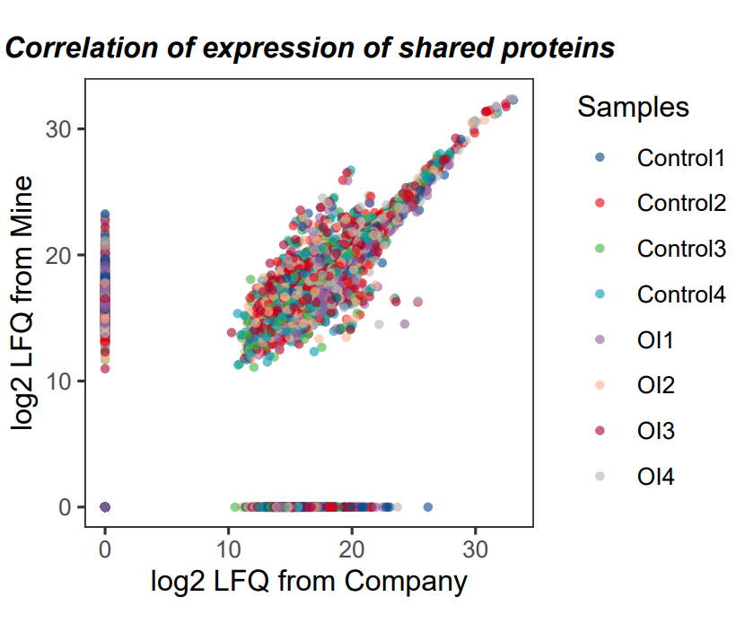
Correlation analysis (cleavages=2)
Compared with company reports
Gene expression analysis
OI_IFITM5
OI_WNT1
OI_WNT2
OI_WNT3
Notes:
The scatter plot showing the linear correlation of my protein expression data and company’s protein expression data after quantitation.

Slide 18
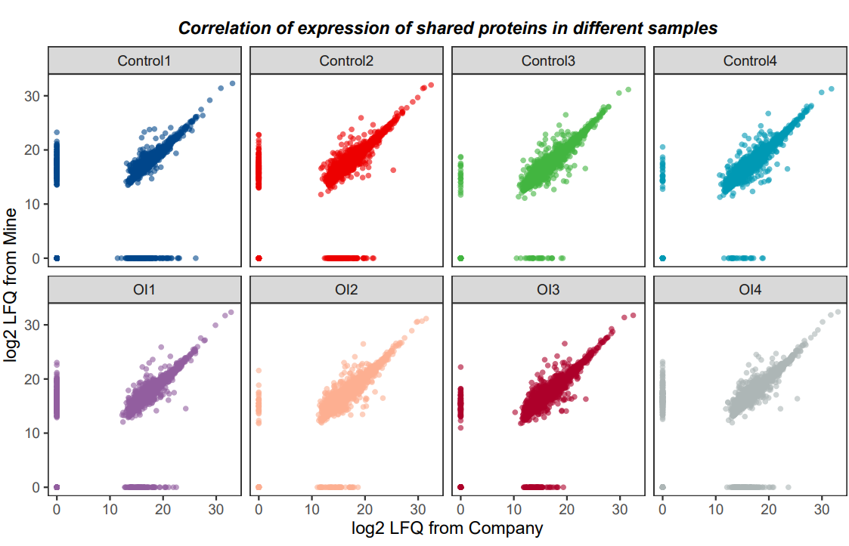
Correlation analysis (cleavages = 2)
Compared with company reports
Gene expression analysis
OI_IFITM5 OI_WNT1 OI_WNT2 OI_WNT3
Notes:
The scatter plot showing the linear correlation of my protein expression data and company’s protein expression data after quantitation.

Slide 19
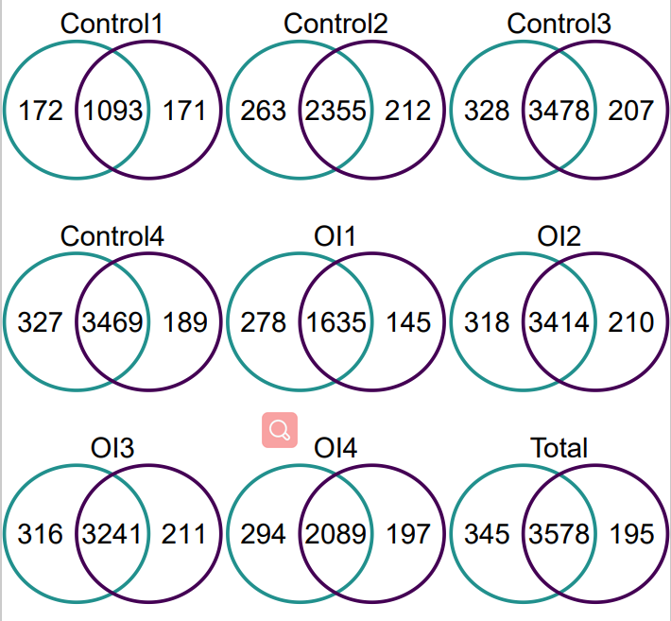
Correlation analysis
Compared with company reports
Venn plot for detected protein
Mine: green (cleavages=2)
Company: purple
OI_IFITM5
OI_WNT1
OI_WNT3
OI_WNT2
Notes:
The Venn plot showing the number of shared and exclusive detected proteins of my protein expression data and company’s protein expression data.

Slide 20
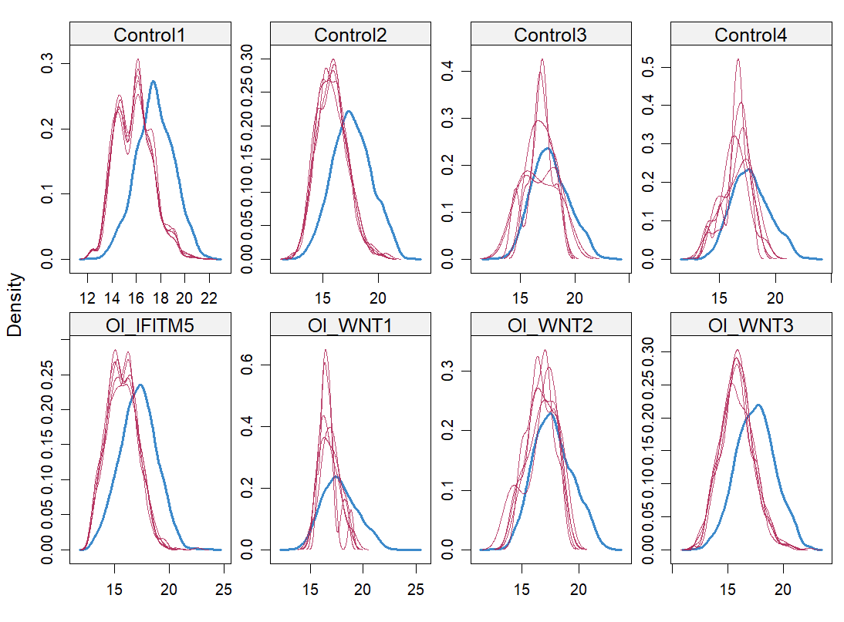
Data winsorization and imputation of the protein expression matrix of samples
The new subset includes:
75.8% of all valid values, 37.7% of all missing values
S4. Density plot of the observed and imputed data for all the samples
Notes:
In the protein expression matrix, proteins whose expression can be detected in at least 5 samples were used for the PCA plot. This new subset includes 75.8% of all valid values, 37.7% of all missing values. Since the subset of data still contains some missing values, an imputation strategy was adopted employing the Multiple Imputation by R package MICE, with a max iteration set at 50 and the default PMM method (predictive mean matching). To further ensure normality, winsorization was applied such that genes whose average is below 5% or above 95% of all genes were also excluded from PCA. The data was then profile-wise standardized (zero-mean and one standard deviation) before PCA was applied.
S4. Density plot of the observed and imputed data for all the samples. The blue line is the observed data, the red lines are the imputed data.

Slide 21
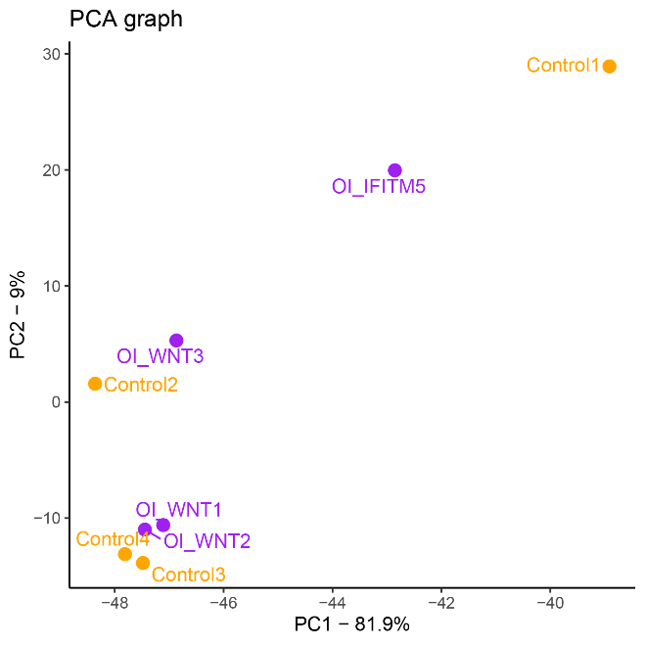
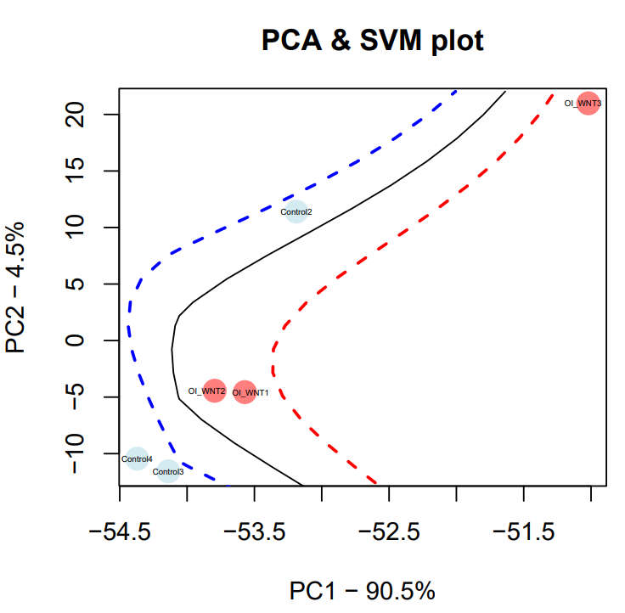
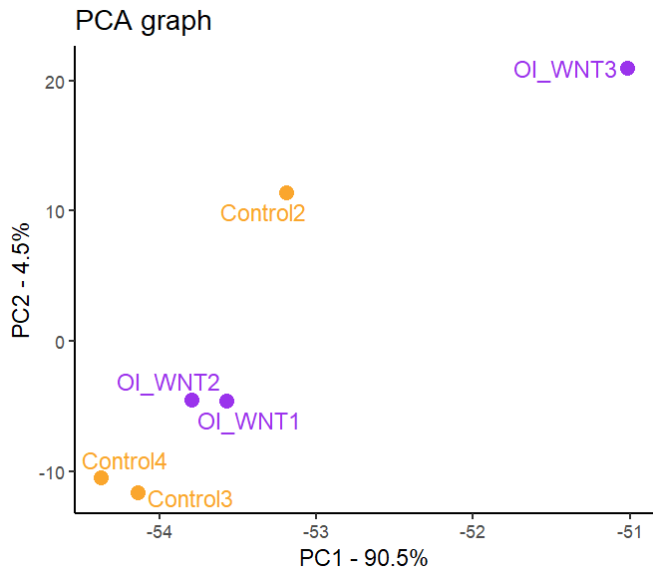
a.
Fig7. PCA plot on PC1, PC2 of the OI group and the Control group
After discarding the samples Control1, OI_IFITM5:
b.
c.
Notes:
Fig7. PCA plot of samples on PC1 and PC2 of samples.
PCA plot colour-coded by the OI and Control groups. It can be seen that the sample OI_IFITM5 and the sample Control 1 are far from other samples.
b-c. PCA plot colour-coded by the WNT1-OI cohort and the Control group (Control 2, 3, 4). The SVM boundaries are trained between the WNT1-OI cohort and the Control group (Control 2, 3, 4).

Slide 22
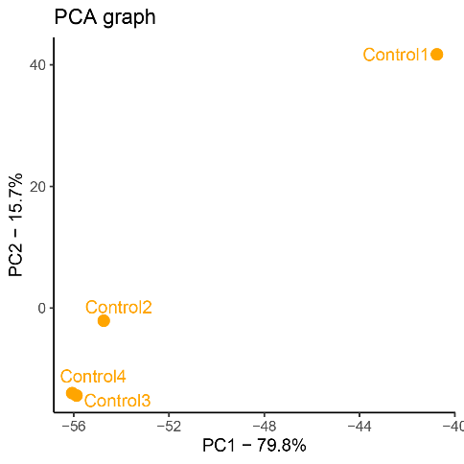
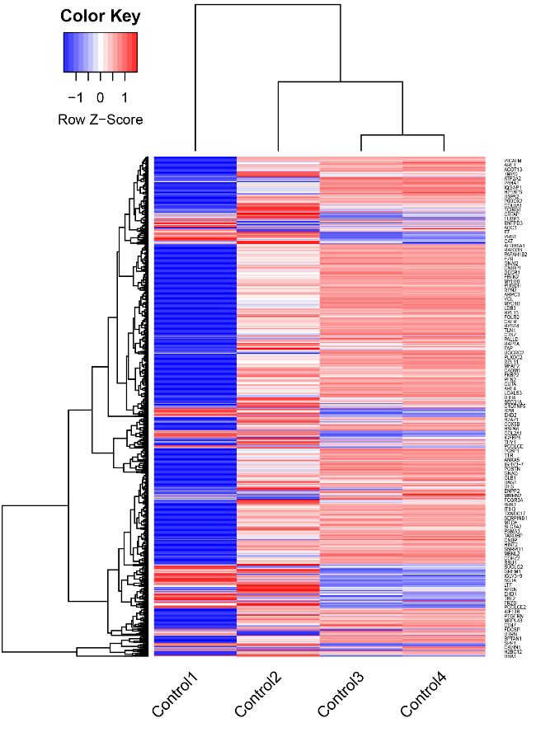
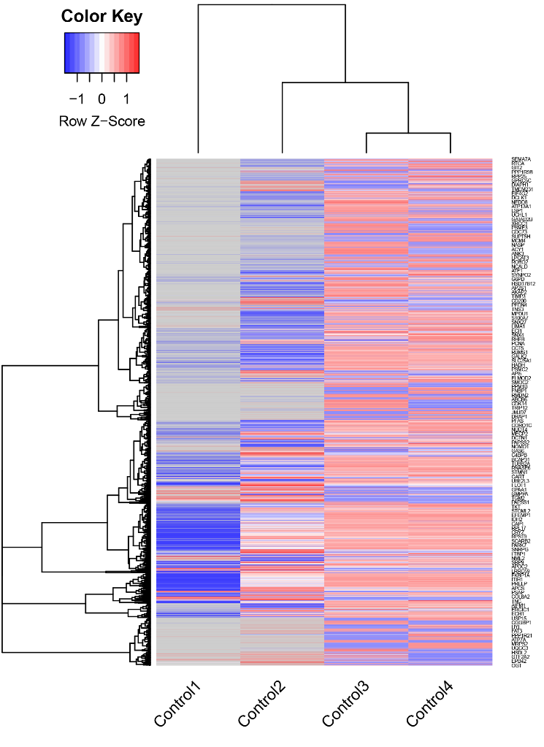
a.
→ Discard Control1
Fig8. PCA plot and heatmap of the Control group
b.
c.
Valid=4
Valid>=2
Sample repeatability:
Control1 had the poorest performance
Notes:
Fig8. PCA plot on PC1 and PC2 of the Control group.
PCA plot colour-coded by the Control groups. It can be seen that the sample Control 1 are far from other Control group samples.
b-c. Heatmap of the Control group (Control 2, 3, 4).
From Fig8. We can see that regarding to the Sample repeatability, sample Control1 had the poorest performance. So it is discarded.

Slide 23
Find DEPs of Control group vs WNT1-OI Cohort Control group samples: Control 2, Control 3, Control 4 WNT1-OI Cohort samples: OI_WNT1, OI_WNT2, OI_WNT3

Slide 24
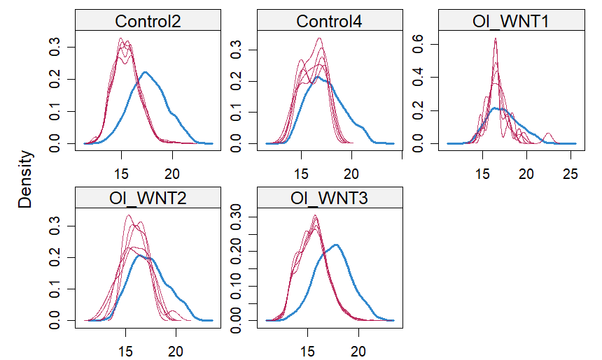
1. Find statistical DEPs
Selected samples: Control 2, 3, 4 OI_WNT 1, 2, 3
Filter criteria: Num_valid_Ctrl>=2, Num_valid_OI_WNT>=2
The new subset includes:
85.6% of all valid values, 50.7% of all missing values
PS: Control3 had only one NA value in the new subset so it is not shown in the density plot
S5. Density plot of the observed and imputed data for the selected samples
Notes:
DEPs: differentially expressed proteins.
To obtain the DEPs. We select the samples Control 2, Control 3, Control 4 as the control group; OI_WNT1, OI_WNT2, OI_WNT3 as the OI_WNT1 Cohort.
The DEPs are defined in two strategies. The first strategy is the Statistical DEPs.
To obtain the statistical DEPs, the following criteria is applied to filter the protein rows of the protein expression matrix: the expression of the protein should be detected in at least 2 samples for each group. This new subset contains 3147 proteins, includes 85.6% of all valid values, 50.7% of all missing values. Since the subset of data still contains some missing values, an imputation strategy was adopted employing the Multiple Imputation by MICE R package with a max iteration set at 50 and the default PMM method (predictive mean matching). Winsorisation was applied such that genes whose average is below 5% or above 95% of all genes were also excluded.
S5. supplementary figure. S5. Density plot of the observed and imputed data for the selected samples. Control3 had only one NA value in the new subset so it is not shown in the density plot.

Slide 25
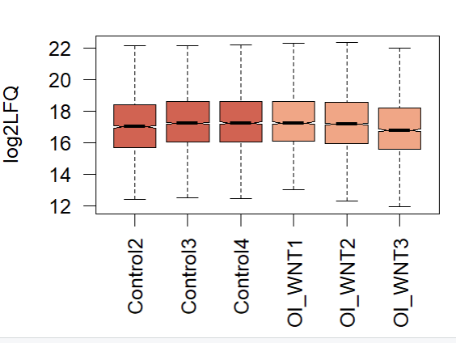
S6. Boxplot of Log2LFQ value of the selected samples after imputation

Slide 26
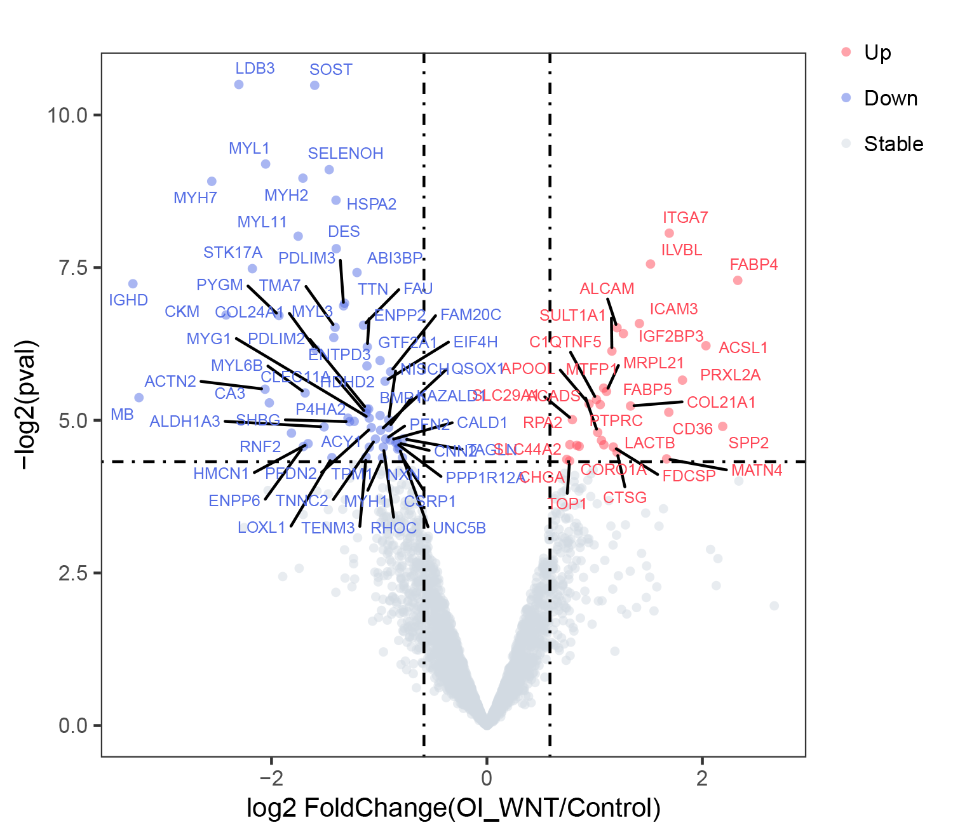
Fig9. Volcano plot of the statistical DEPs (n=88)
Notes:
Then, the differential expression analysis is conducted by limma R package on the matrix after imputation. The protein with p>0.05 and |FC| > 2 was considered as statistical DEPs.
Fig9. Volcano plot of the statistical DEPs (Control group vs WNT1-OI Cohort)

Slide 27
Table2. Statistical DEPs in protein categories (n=88)
 | Higher_in_OI_WNT | Higher_in_Control
ECM Glycoproteins | MATN4 | ABI3BP, HMCN1
Collagens | COL21A1 | COL24A1
Proteoglycans
ECM-affiliated Proteins | C1QTNF5 | CLEC11A
ECM Regulators | CTSG | FAM20C, BMP1, P4HA2, KAZALD1, LOXL1
Secreted Factors
Non-matrisome | ITGA7, ILVBL, FABP4, ICAM3, ALCAM, IGF2BP3, ACSL1, SULT1A1, PRXL2A, MTFP1, MRPL21, APOOL, FABP5, CD36, SLC29A1, SPP2, ACADS, PTPRC, SLC44A2, LACTB, RPA2, CORO1A, FDCSP, CHGA, TOP1 | LDB3, SOST, MYL1, SELENOH, MYH2, MYH7, HSPA2, MYL11, DES, STK17A, IGHD, TTN, PDLIM3, CKM, PYGM, FAU, TMA7, MYL3, ENPP2, GTF2A1, ENTPD3, EIF4H, ACTN2, MYL6B, MB, CA3, HDHD2, PDLIM2, MYG1, NISCH, ACY1, SHBG, ALDH1A3, PFDN2, QSOX1, RNF2, TAGLN, PFN2, TNNC2, CALD1, CNN2, PPP1R12A, ENPP6, RHOC, TPM1, UNC5B, NXN, TENM3, CSRP1, MYH1
Notes:
Table2. Statistical DEPs in protein categories.
COL21A1 might be important protein in pathogenesis of OI disease.

Slide 28
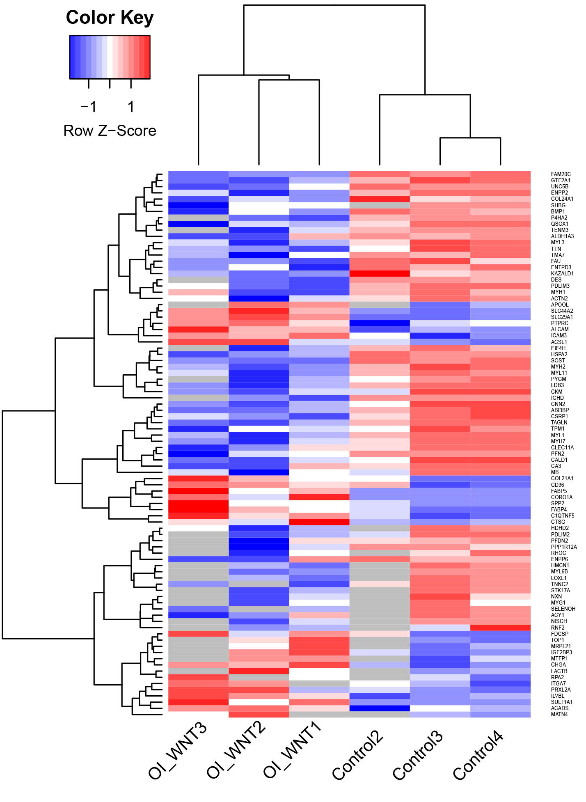
Fig10. Heatmap of the statistical DEPs (n=88)
Notes:
Fig10. Heatmap of the statistical DEPs. The OI-WNT1 Cohort and the Control group cluster well separately.

Slide 29
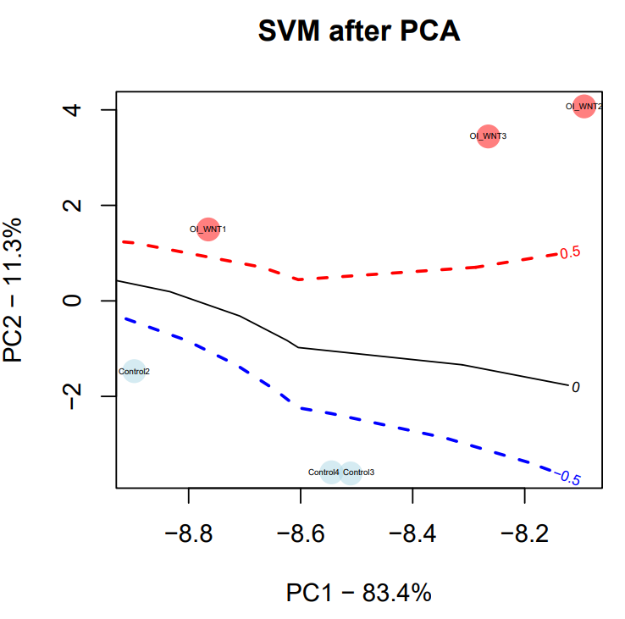
Fig11. PCA plot of the statistical DEPs
Notes:
Fig11. PCA plot of the statistical DEPs. The SVM boundaries are trained between the WNT1-OI cohort and the Control group.

Slide 30
2. Find exclusive DEPs (only expressed in one Group)
Filter criteria:
Num_valid_Ctrl>=2 & Num_valid_OI_WNT==0 or
Num_valid_OI_WNT>=2 & Num_valid_Ctrl==0
Notes:
The second strategy is the exclusive DEPs.
The proteins where one group has at least 2 valid values (protein expression detected in 2 samples of the group) while the other group is completely not detected, are considered as exclusive DEPs.

Slide 31
Table3. Exclusive DEPs in protein categories (n=82)
 | Higher_in_OI_WNT | Higher_in_Control
ECM Glycoproteins | MFAP5 | ELN, FBLN7, GLDN
Collagens
Proteoglycans | PRG3, PRG2
ECM-affiliated Proteins |  | GPC4
ECM Regulators | LPA | CTSO, LOXL2
Secreted Factors | S100B, HGFAC
Non-matrisome | PLIN1, MGST1, DCXR, IGHV1-69D, SCD, RAB27A, LIPE, CSTF3, ABHD5, ZFP14 | CLSTN1, CASP14, ACTN3, SYNPO, MYOZ1, SNX7, PADI2, IGKV1-27, HAX1, RNMT, KIF1A, KLHL41, PFKFB1, TACC1, WDR47, SEC24A, IGLV3-1, HLA-DQB1, JMJD7, HLA-DRB4, CKMT2, EPHX2, NUP107, RPL31, TNNC1, UBE3A, FCHO2, PAK1, DNAJC3, FHL2, LAGE3, TRIP12, SLMAP, FILIP1L, SAMD4B, LYPLAL1, INO80C, TRIM72, IRF2BP1, SLC44A5, PREX1, MYOZ3, CEMIP, UBTD2, CUL5, TRERF1, SDHC, NPL, LHPP, ATG5, MYOZ2, CD163L1, SH3GLB2, MYEF2, CLIP2, CDV3, ZNF346, POFUT2, RABGAP1, MYH4
Notes:
Table3. Exclusive DEPs in protein categories

Slide 32
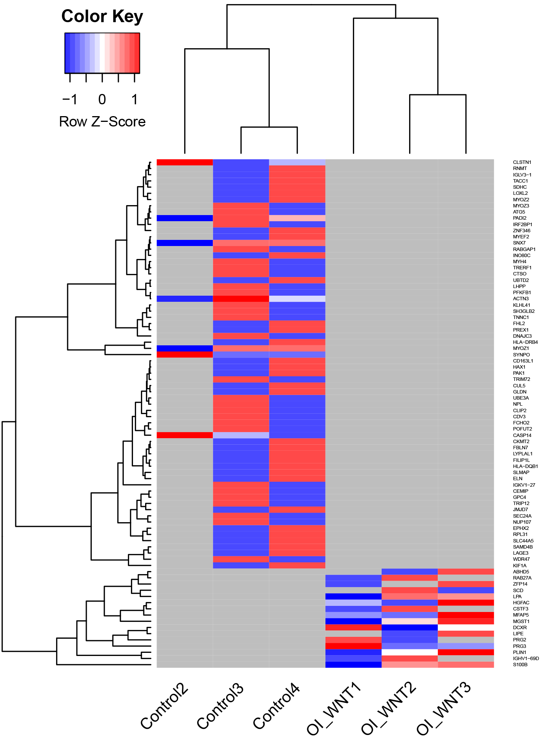
Fig12. Heatmap of the exclusive DEPs (n=82)
Notes:
Fig12. Heatmap of the exclusive DEPs. The OI-WNT1 Cohort and the Control group cluster well separately.

Slide 33
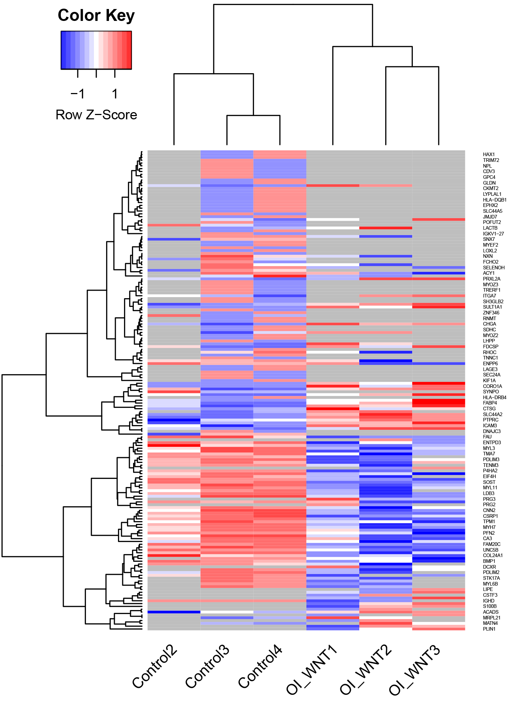
Fig13. Heatmap of the total DEPs
(statistical DEPs + exclusive DEPs,
n=170)
Notes:
Then the statistical DEPs and the exclusive DEPs are merged together as the total DEPs.
Fig13. Heatmap of the total DEPs (statistical DEPs + exclusive DEPs). The OI-WNT1 Cohort and the Control group cluster well separately.

Slide 34
GO/KEGG enrichment of total DEPs

Slide 35
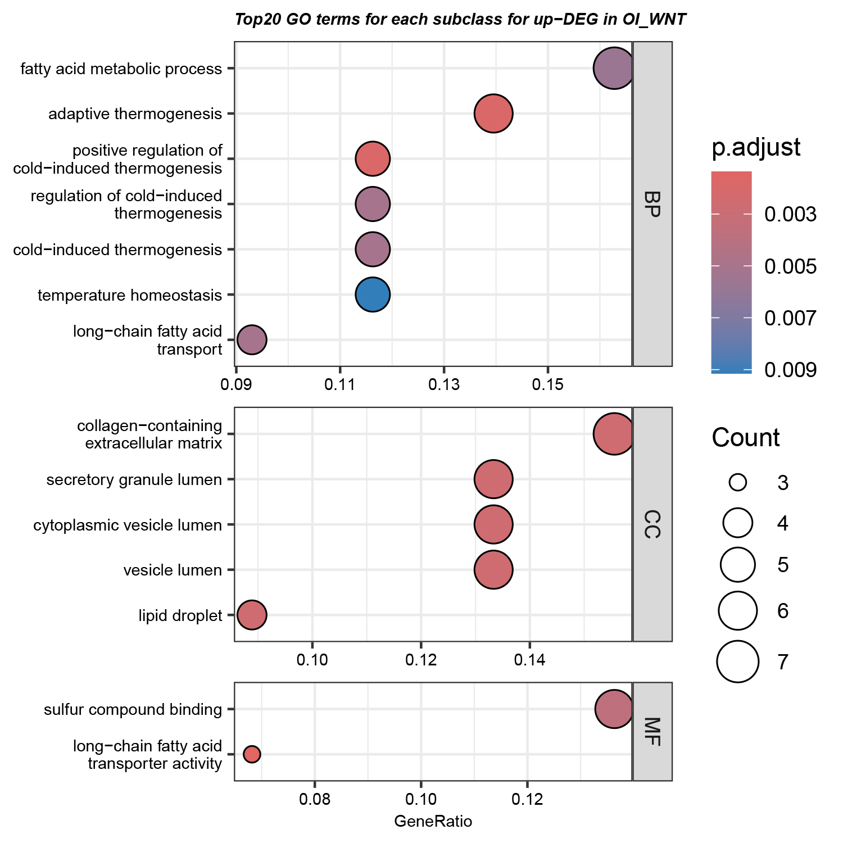
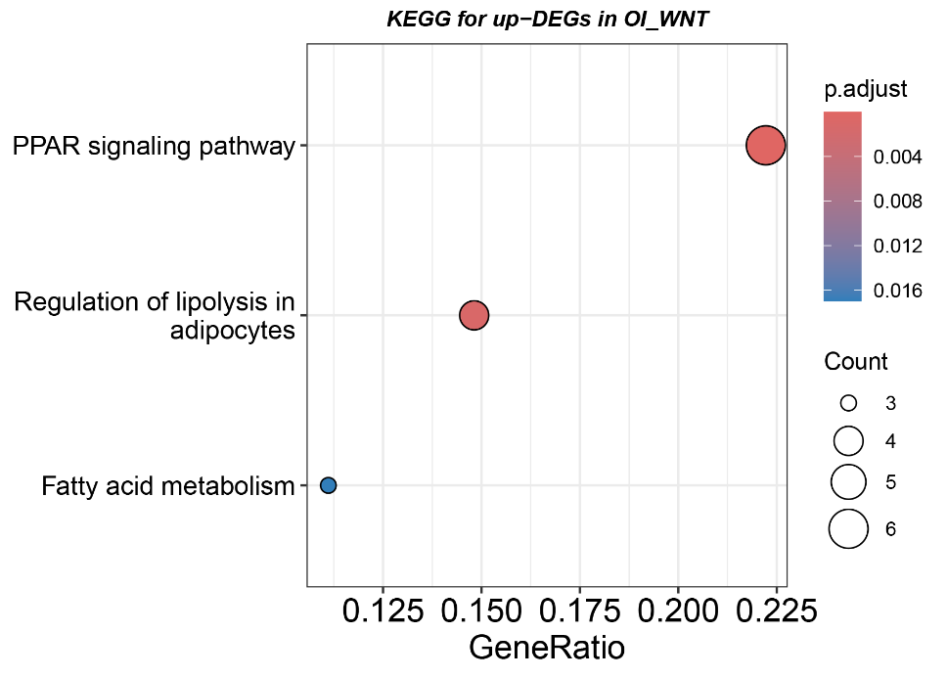
Fig14. GO/KEGG enriched terms of up-DEPs in the OI-WNT1 cohort
Related to osteoblast differentiation?
Notes:
The obtained total DEGs were used to conduct the GO/KEGG enrichment.
Fig14. GO/KEGG enriched terms of up-DEPs in the OI-WNT1 cohort.

Slide 36
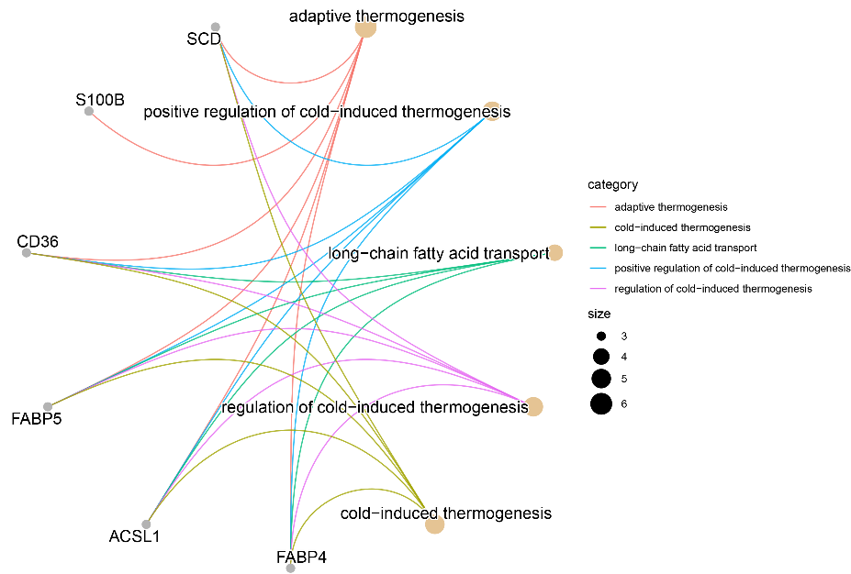
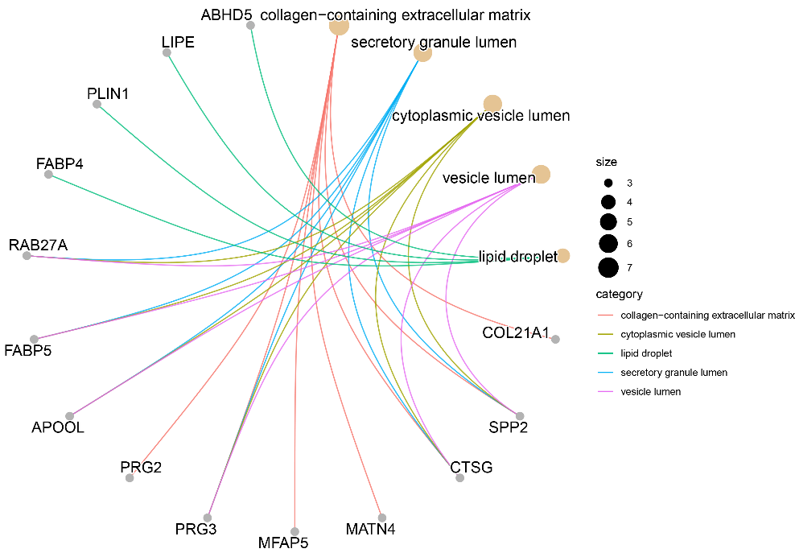
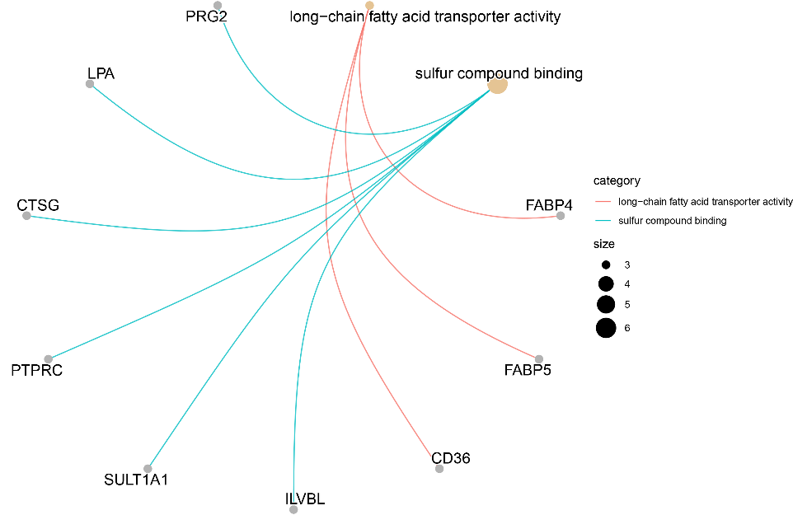
Fig15. Up-DEP GO network
a. BP
b. CC
c. MF
Notes:
Fig15. GO network for up-DEPs in the OI-WNT1 Cohort . a-c. Up-DEP GO network for BP (biological process), CC (cellular component), and MF (molecular function) terms, separately.

Slide 37
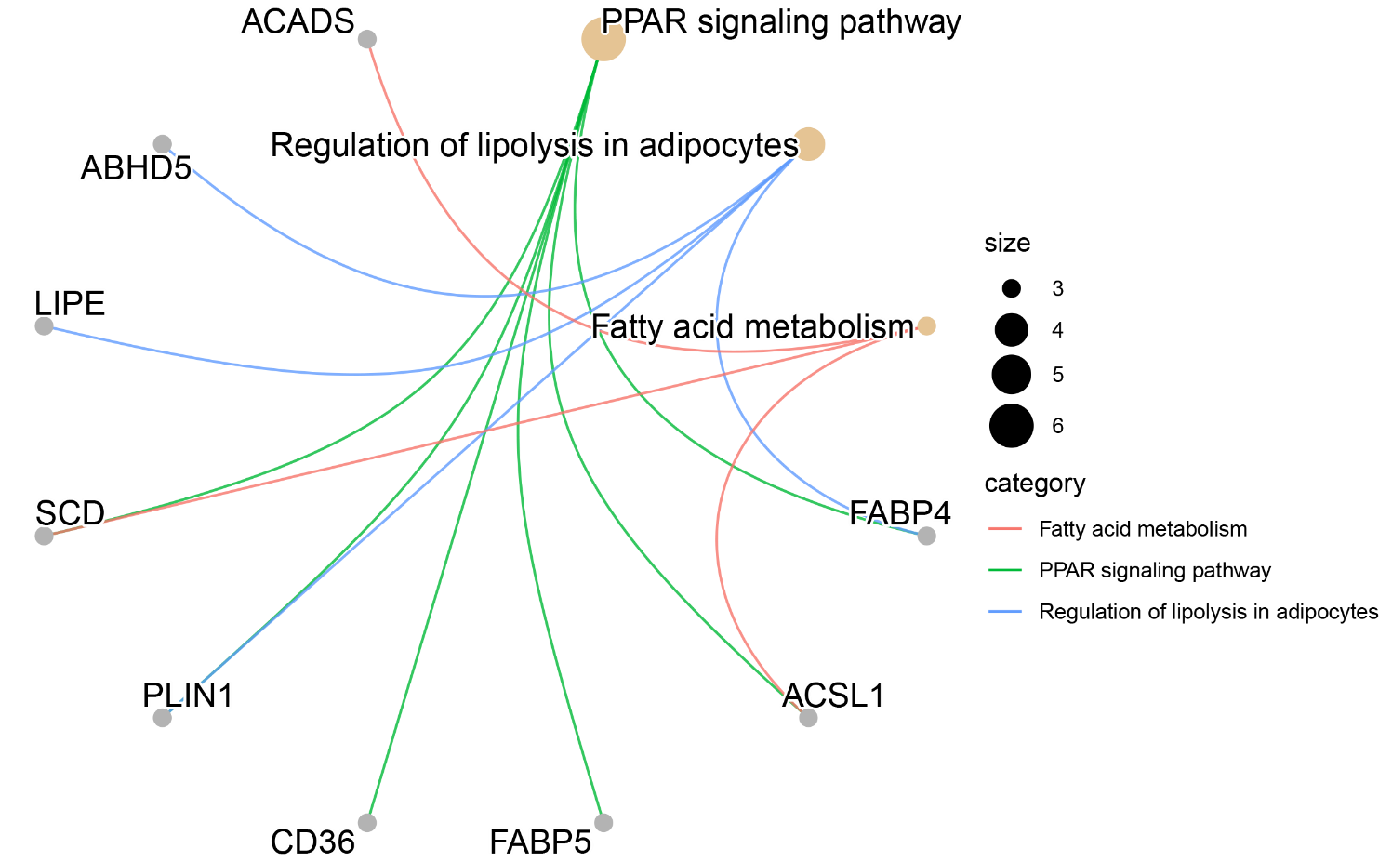
Fig16. Up-DEP KEGG network
Notes:
Fig16. KEGG network for up-DEPs in the OI-WNT1 Cohort.

Slide 38
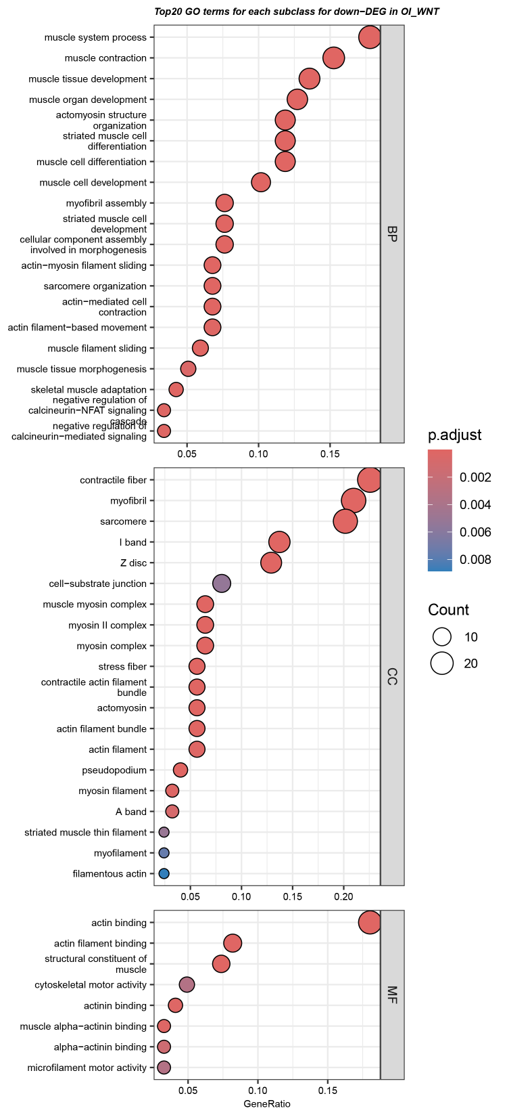
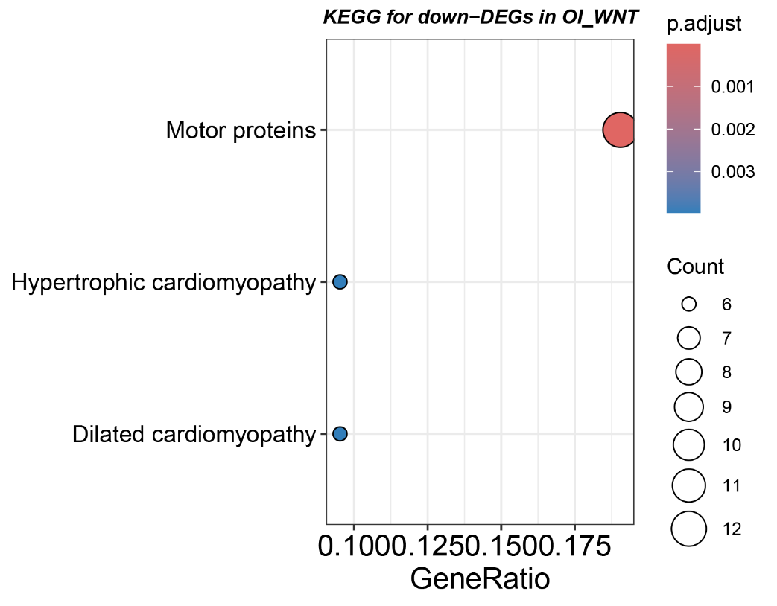
Fig17. GO/KEGG enriched terms of down-DEPs in the OI-WNT1 cohort
Notes:
Fig17. GO/KEGG enriched terms of down-DEPs in the OI-WNT1 cohort

Slide 39



Fig18. Down-DEP GO network
a. BP
b. CC
c. MF
Notes:
Fig18. GO network for down-DEPs in the OI-WNT1 Cohort . a-c. Down-DEP GO network for BP (biological process), CC (cellular component), and MF (molecular function) terms, separately.

Slide 40

Fig19. Down-DEP KEGG network
Notes:
Fig19. KEGG network for down-DEPs in the OI-WNT1 Cohort.

Slide 41

DEPs in PPAR signaling pathway (red: up-DEPs, blue: down-DEPs)

Slide 42

DEPs in Motor protein pathway (red: up-DEPs, blue: down-DEPs )

Slide 43


Full PPI network of DEPs
Notes:
The DEPs were analyzed on the website STRING-db to obtain the full or physical PPI network of DEPs.

Slide 44



Fig20. Important Module 1 (20 nodes, 171 edges)
Notes:
The full PPI network was imported into Cytoscape to further analyze. Module 1 (20 nodes, 171 edges) was obtained by the tool MCODE. The DEPs on the Module 1 were all down-DEPs, which were further conducted the GO/KEGG enrichment.

Slide 45
Key genes selected by cytohubba
CKM, MB, MYOZ2, MYL3, MYH1, MYL1, ACTN3, TNNC1, MYLPF, MYH4, MYH7, TTN, KLHL41, ACTN2, PYGM, MYOZ1, MYH2
They are all down-DEPs.
Notes:
Shared hub DEPs of the output of the 5 algorithms NCC, DNNC, NNC, Degree, EPC (by cytohubba) are considered as important key genes, which are also the part of the DEPs of module 1.

Slide 46


Physical network of DEPs

Slide 47
Thank you!

